Slide 1



FACULTY OF INFORMATION TECHNOLOGY
Title: Graduation Project Seminar I
Misr University for Misr University for Science and Technology
College of Information Technology
A Graduation Project Report Submission in Partial Fulfillment of the Requirements for the award of the degree
Bachelor of Information Technology
FAIR: A Computer Vision System for Fair Talent Discovery
Under Supervision of
Prof. Dr. Elsayed Badr
T.A Aya Taha

Slide 2

Agenda
Introduction
Problem Definition
Project Objectives
Related Works
Proposed System
System Architecture
Software Process Model
UML
UI/UX Design
Implementation Tools
Expected Outcome (Including SDGs)
Project Plan (Gantt Chart)
Conclusion
References (IEEE Format)

Slide 3
Introduction
In the traditional process of discovering talented athletes, scouts and coaches rely heavily on physical tryouts and in-person evaluations. This method is not only time-consuming but also inefficient, as it often fails to give equal attention to every participant. Thousands of athletes compete for limited opportunities, making it nearly impossible for coaches to identify every promising talent. This outdated approach is further compounded by the high costs and physical exhaustion associated with tryouts, creating barriers for young athletes to showcase their potential.
Talent Vision introduces a revolutionary, modern approach to talent discovery by leveraging the power of a mobile app equipped with cutting-edge technology. Designed to address the inefficiencies of the traditional system, Talent Vision transforms the scouting process into an accessible, fair, and data-driven experience. The app will cater to multiple sports, making it a versatile tool for discovering talent across various athletic disciplines.

Slide 4
Introduction
The project’s core features reflect its commitment to transformative healthcare access:
Real-Time Facility Location and Availability: Parents can instantly find nearby NICU facilities, complete with occupancy details and predictive discharge times, ensuring they can secure care without unnecessary delays.
1
Proactive Notifications: Using predictive algorithms, the system notifies families of potential availability in neonatal units, enabling better planning.
2
Enhanced Communication Tools: Parents have direct access to healthcare providers via secure messaging, voice reports, and contact details, fostering transparency and understanding of their child’s health.
3
Comprehensive Health Monitoring: Regular updates, in both written and audio formats, give parents a clear view of their child’s condition and the remaining duration of NICU care.
4
AI-Driven Assistance: The chatbot offers instant responses to common questions about nutrition, medications, or general neonatal health, reducing dependency on in-person consultations and alleviating anxiety.
5

Slide 5
Problem Definition.
The current athletic tryout process is riddled with inefficiencies that limit its effectiveness. The key problems include:
Overcrowded Tryouts: Thousands of athletes compete for limited attention, making it challenging for scouts to identify promising talents. This leads to many potential stars being overlooked.
Limited Attention: Scouts struggle to effectively evaluate each athlete in the limited time available, which often results in unfair or incomplete assessments.
Costly and Exhausting Process: The traditional tryout process is expensive for athletes who need to travel and exhausting due to the physical and mental toll of multiple tryouts. These factors hinder their performance and motivation.

Slide 6
Project Objectives
Talent Vision combines its objectives with innovative features to address the inefficiencies of traditional tryouts and modernize the scouting process:
Revolutionize Talent Discovery with Video Upload & Analysis: Athletes can record and upload videos of their skills and performance, eliminating the need for physical tryouts. This ensures that all athletes have equal opportunities to be seen by scouts.
Democratize Access Through Multi-Sport Support: The app supports multiple games, ensuring inclusivity across various athletic disciplines. Every athlete, regardless of location or financial status, can participate in the scouting process.
Enhance Evaluation Accuracy with Performance Feedback Using AI: The app employs AI algorithms to analyze video footage, providing scouts with objective insights into an athlete’s technique, potential, and areas for improvement. This technology eliminates bias and enhances the accuracy of evaluations.
Foster Growth Through Progress Tracking: Athletes can monitor their development over time through data-driven insights, helping them identify strengths and areas to work on. This feature helps athletes stay motivated and continuously improve.
Promote Collaboration with Professional Insights: Collaborations with professional coaches and athletes enable the app to provide valuable feedback and guidance, fostering growth and development among young athletes.

Slide 7
Related Works
1. Hudl
Objectives:
Provide athletes with a platform to upload and share gameplay videos.
Enable coaches to analyze player performance and create highlight reels.
Facilitate collaboration between teams, athletes, and scouts.
Development Tools:
Backend: Python, Node.js.
Frontend: React.js.
Video Processing: FFmpeg.
Cloud Storage: AWS for scalable video storage and retrieval.
AI/ML: Custom-built algorithms for video tagging and analysis.
Advantages:
Comprehensive platform for video analysis and sharing.
Widely used by professional and amateur athletes alike.
Strong focus on team collaboration.
Disadvantages:
Primarily focused on team sports like football and basketball.
Requires subscription fees, limiting accessibility for underprivileged athletes.

Slide 8
Related Works
2. Coach's Eye
Objectives:
Offer athletes and coaches a tool for slow-motion video review.
Improve technical feedback through video annotations and analysis.
Development Tools:
Mobile App Framework: Swift (iOS) and Kotlin (Android).
Video Playback: OpenGL for frame-by-frame analysis.
Cloud: Google Firebase for data storage and sharing.
Advantages:
User-friendly interface with powerful video annotation tools.
Great for individual feedback during training.
Disadvantages:
Limited to video analysis without AI insights.
Requires manual annotations, which can be time-consuming..

Slide 9
Related Works
3. Dartfish
Objectives:
Provide athletes and coaches with video tagging and motion analysis.
Enable data-driven feedback for performance improvement.
Development Tools:
Video Analysis: Custom algorithms for motion tracking.
Data Storage: On-premise and cloud-based storage options.
Cross-platform App Development: Java and C#.
Advantages:
Highly detailed analysis, especially useful for technical sports.
Supports tagging specific moments in videos for precise feedback.
Disadvantages:
Expensive and targeted towards professional sports organizations.
Steeper learning curve for new users.

Slide 10
Related Works
4. HomeCourt (Basketball Focused)
Objectives:
Use AI to analyze basketball training sessions and provide performance feedback.
Track stats like shooting accuracy, speed, and positioning.
Development Tools:
AI Frameworks: TensorFlow and PyTorch for motion detection.
Video Processing: OpenCV.
Cloud Infrastructure: Google Cloud for real-time processing.
Advantages:
Highly specialized for basketball players.
Real-time AI-based performance analysis.
Disadvantages:
Restricted to basketball; not suitable for other sports.
Requires high-quality cameras for accurate analysis.

Slide 11
Proposed System
Objectives:
Empower Athletes:
Provide a platform where athletes can easily showcase their talent and abilities to scouts and coaches without the need for costly and overcrowded tryouts.
Leverage AI for Talent Evaluation:
Utilize advanced AI algorithms to objectively analyze athlete performances, eliminating human bias and enhancing accuracy in talent identification.
Promote Inclusivity:
Support athletes across multiple sports, particularly focusing on the Arabian community, while ensuring the system is accessible to both technical and non-technical users.
Reduce Barriers:
Create a free, user-friendly application that eliminates financial, geographical, and technical barriers for athletes, allowing greater participation from underprivileged areas.
Facilitate Athlete Development:
Provide tools for athletes to track their progress over time, receive professional insights, and identify areas for improvement.

Slide 12
Proposed System
System Functionalities:
Video Upload and Sharing:
Athletes can upload videos showcasing their skills and performances directly through the app.
Videos are stored securely and made accessible to scouts and coaches.
AI-Based Performance Analysis:
The app uses machine learning and deep learning algorithms to evaluate uploaded videos.
Provides detailed feedback on technique, performance metrics, and areas for improvement.
Progress Tracking:
Allows athletes to monitor their skill development over time using data visualizations and historical records.
Highlights achievements and tracks improvements to motivate athletes.
Multi-Sport Support:
Covers various sports, ensuring inclusivity for athletes from different disciplines.
Collaborative Insights:
Enables professional coaches and athletes to provide personalized feedback on submitted videos.
User-Friendly Design:
Designed for both technical and non-technical users, ensuring ease of use for athletes of all backgrounds.
Supports Arabic and other languages for regional accessibility.
Community Integration:
A social aspect where athletes can connect with peers, coaches, and scouts.
Allows scouts to easily search for talent within their required parameters.
Free and Accessible Platform:
Available on all major platforms (iOS, Android, and Web).
No subscription or hidden fees, making it accessible to all athletes.

Slide 13
Proposed System
Advantages :
Accessibility:
Free for all users, removing financial barriers for young athletes.
Available on multiple platforms, ensuring usability for a wide audience.
Inclusivity:
Supports athletes from all sports and communities, especially focusing on the underserved Arabian region.
Designed to accommodate both technical and non-technical users.
Efficiency:
Eliminates the need for physical tryouts, saving time and resources for athletes and scouts.
AI-based analysis provides faster and more accurate evaluations than traditional methods.
Objectivity:
AI removes human biases in the talent evaluation process, ensuring fair and data-driven assessments.
Development-Oriented:
Progress tracking and professional insights help athletes identify their strengths and weaknesses, motivating continuous improvement.
Scalable Solution:
Can expand to support new sports, regions, or features based on user demand.
Integrates seamlessly with modern technologies for future updates.
Community Impact:
Empowers young athletes, fostering a culture of opportunity and growth in sports.
Bridges the gap between raw talent and professional scouting opportunities.

Slide 14
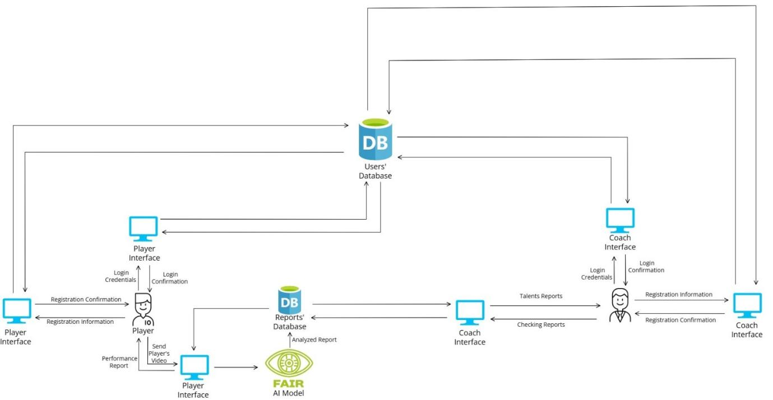
System Architecture

Slide 15
Software Process Model
Agile Model
Overview
Software Development Life Cycle (SDLC) model, The Agile Model is a highly flexible and iterative approach to software development, focusing on collaboration, customer feedback, and rapid delivery of functional software. It emerged as an alternative to traditional models like Waterfall, which are more rigid and sequential. Agile methodologies were formally introduced in 2001 through the Agile Manifesto, emphasizing principles such as individuals and interactions, working software, customer collaboration, and responding to change.
Steps
Planning: Define iteration goals.
Design: Create basic designs.
Development: Build the features.
Testing: Test the iteration.
Evaluation: Collect feedback for the next cycle.
Strengths
Flexibility for changes
Early issue detection
Continuous improvement
Weaknesses
Time-consuming
Risk of scope creep
Resource-heavy
When to Use
Evolving requirements
Frequent feedback needed
Complex projects
Why Use
Adapts to changes
Improves quality through iterations

Slide 16
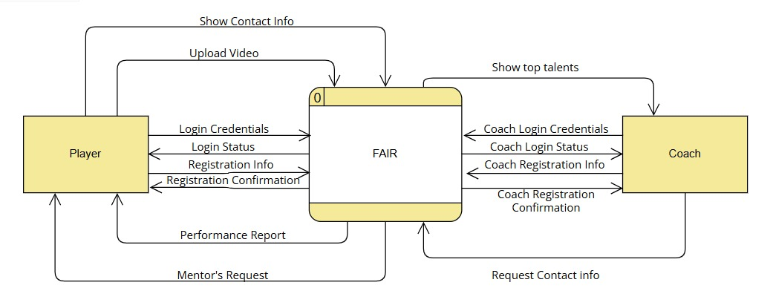
UML (Context Diagram)

Slide 17
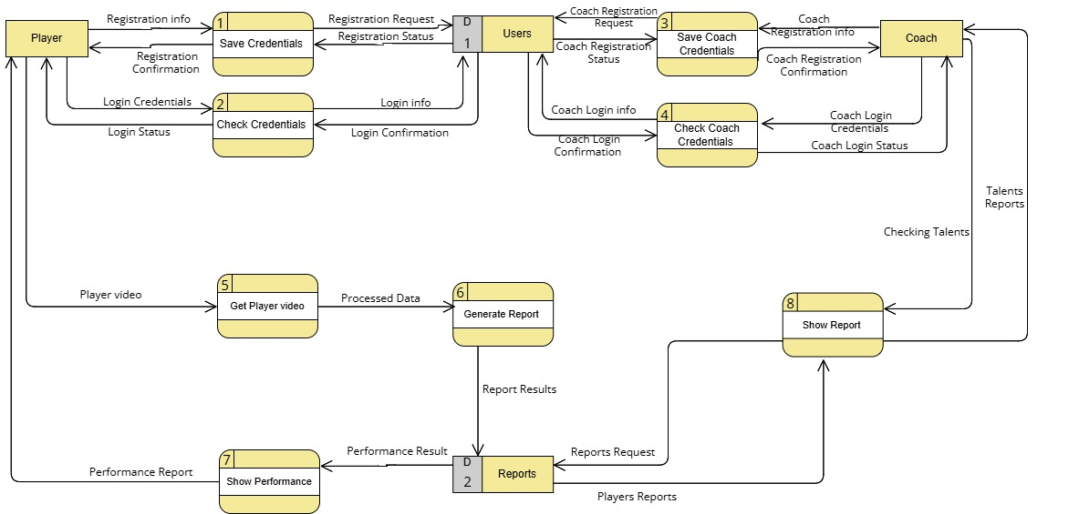
UML (Level 0)

Slide 18
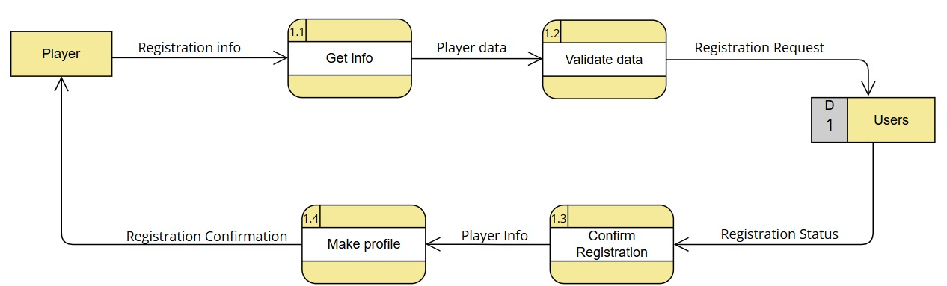
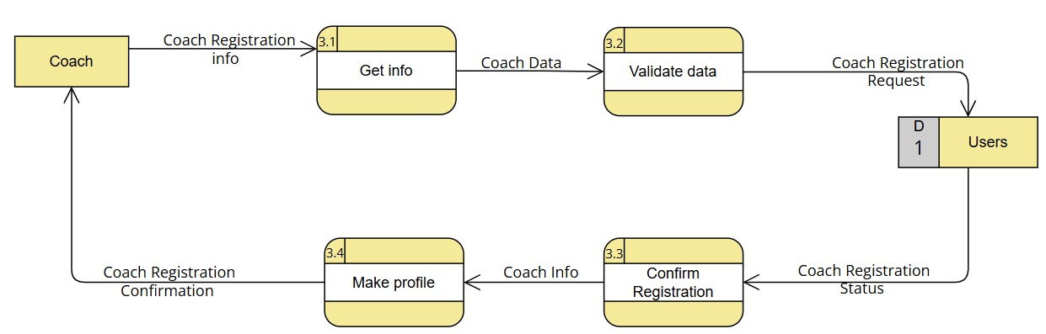
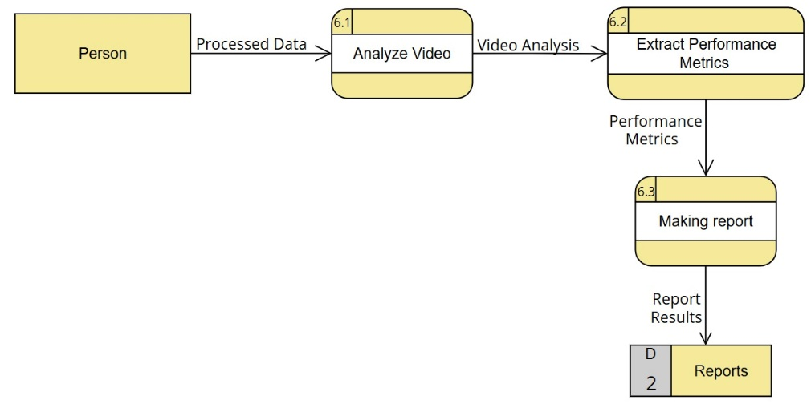
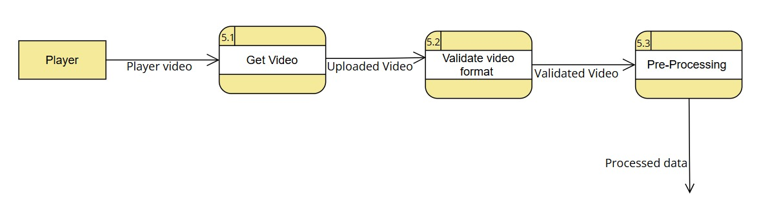
UML (Level 1)

Slide 19
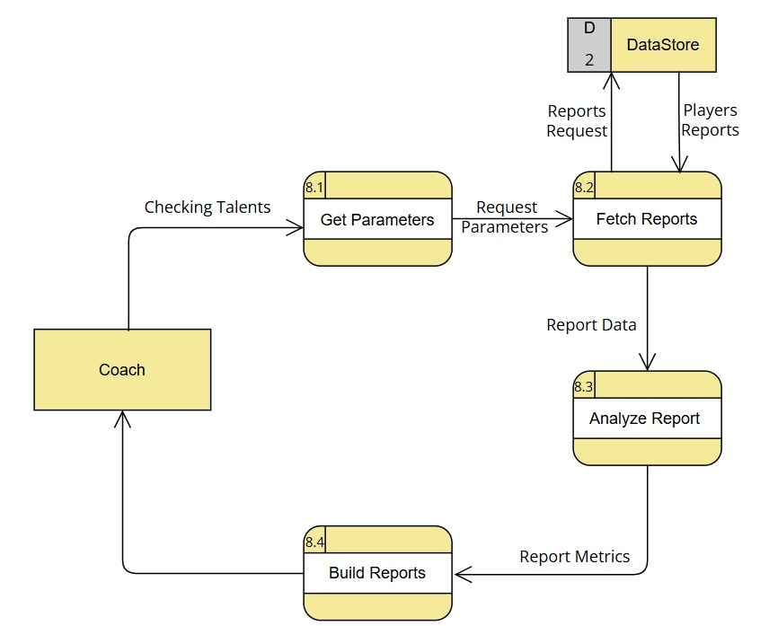
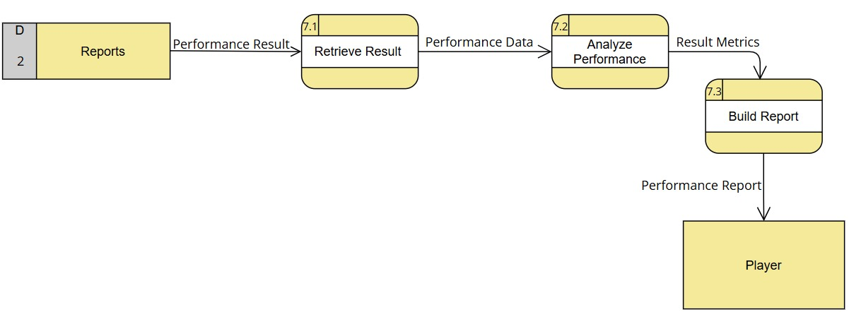
UML (Level 1)

Slide 20
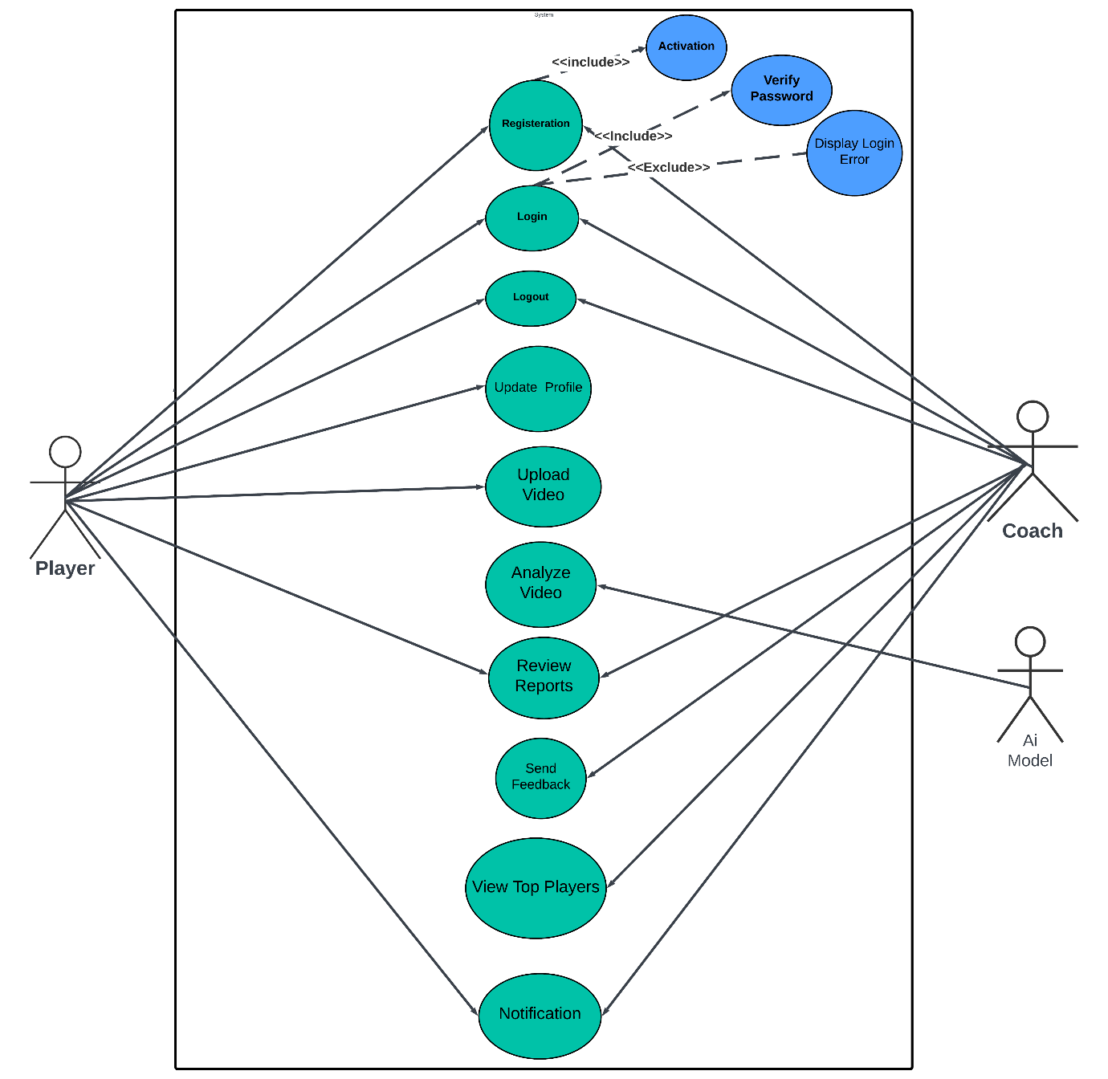
UML (Use Case Diagram )

Slide 21
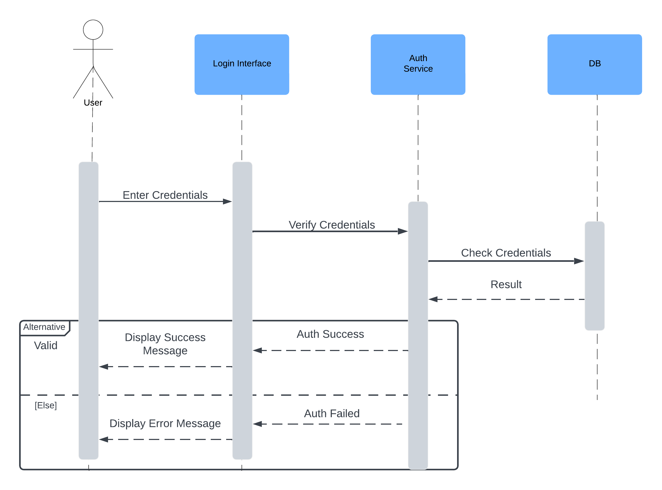
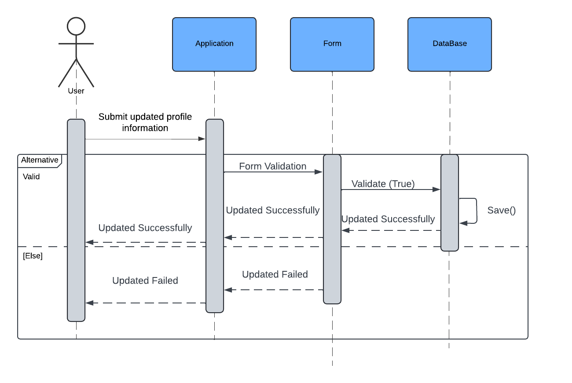
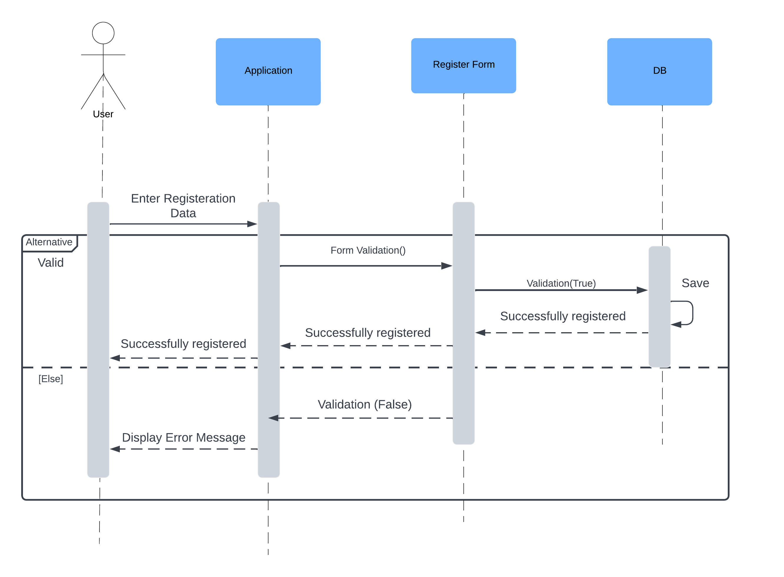
UML (Sequence Diagram)
Registration Sequence Diagram
Login Sequence Diagram
update account Sequence Diagram

Slide 22
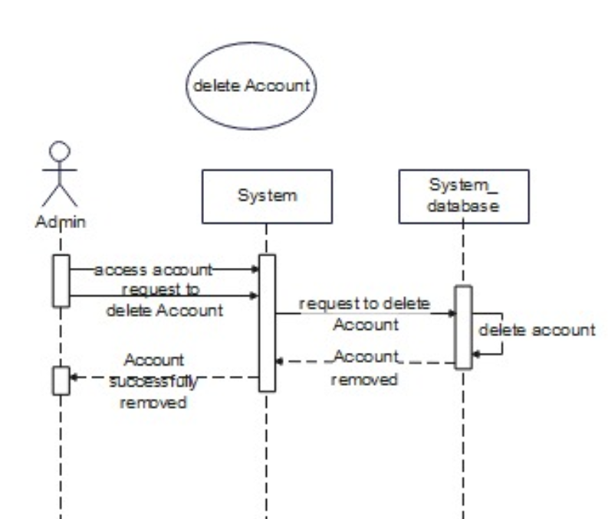
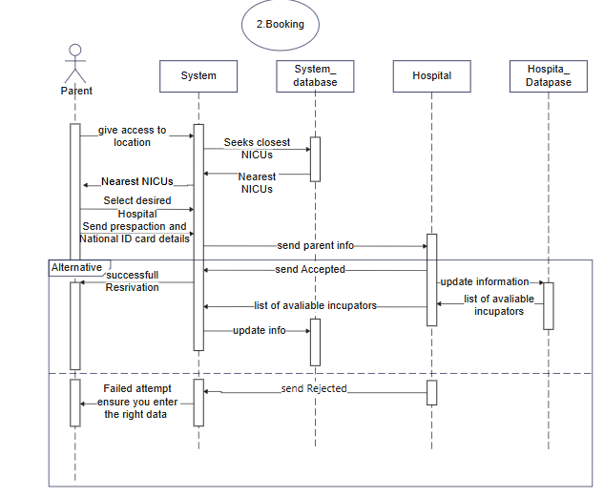
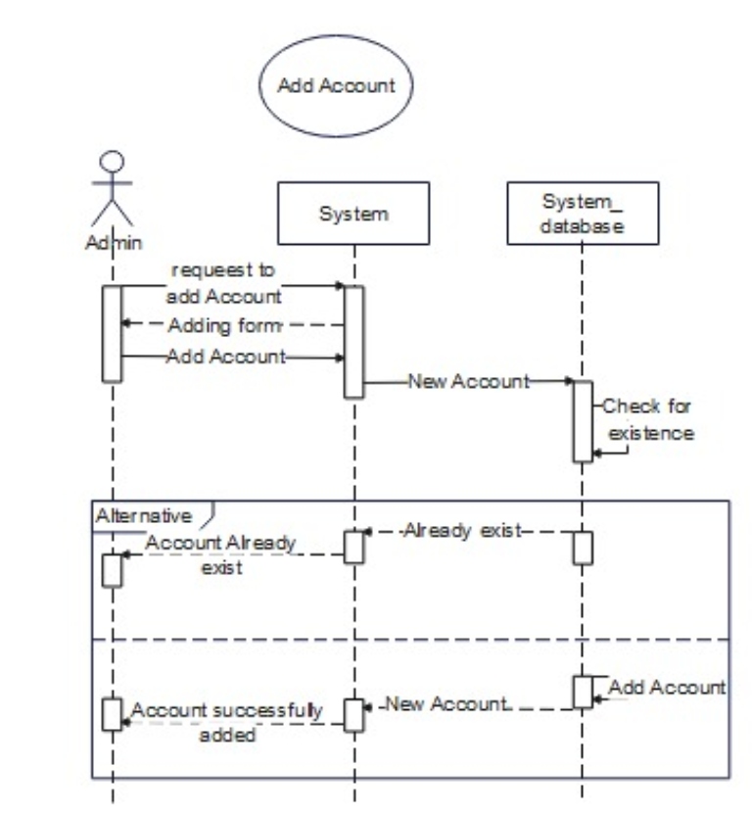
UML (Sequence Diagram)
Delete account Sequence Diagram
booking Sequence Diagram
add account Sequence Diagram

Slide 23
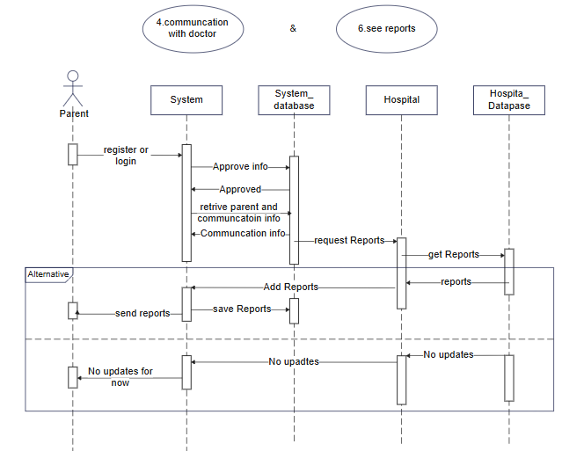
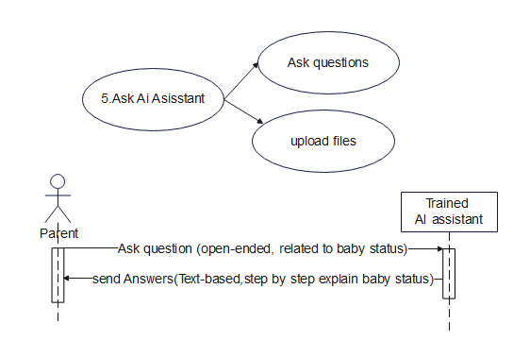
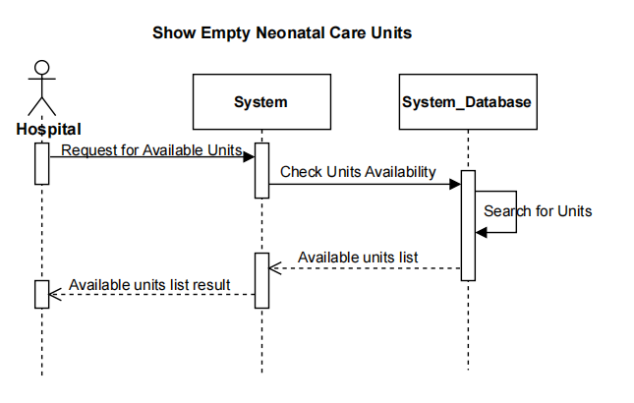
UML (Sequence Diagram)
see reports Sequence Diagram
ask ai assistant Sequence Diagram
show empty units Sequence Diagram

Slide 24
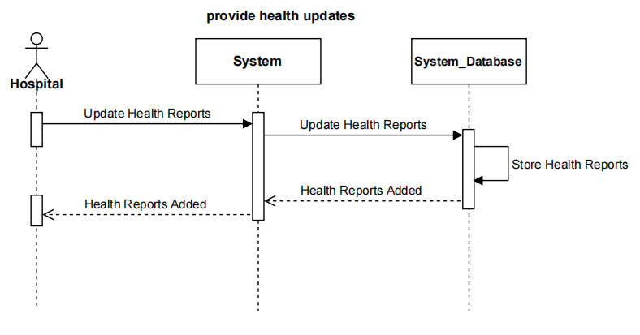
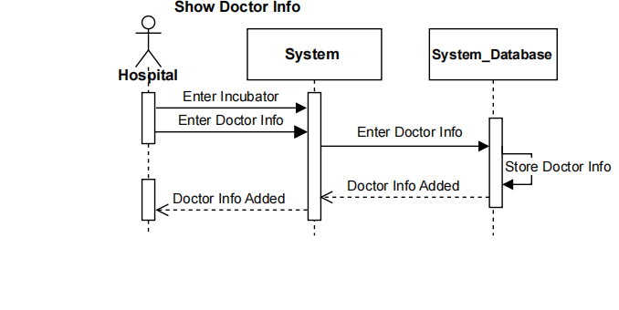
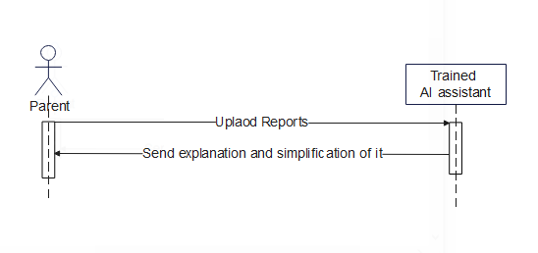
UML (Sequence Diagram)
provide health updates Sequence Diagram
show doctor info Sequence Diagram
upload reports Sequence Diagram

Slide 25
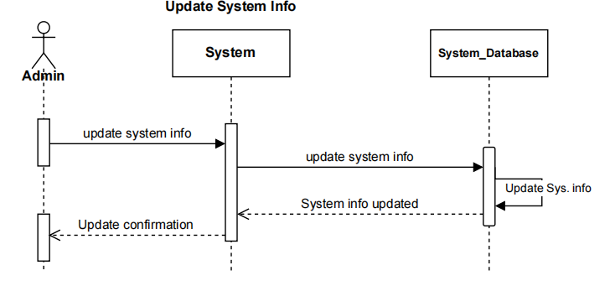
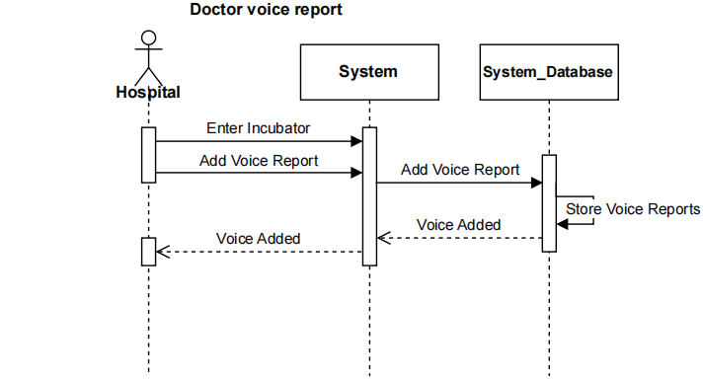
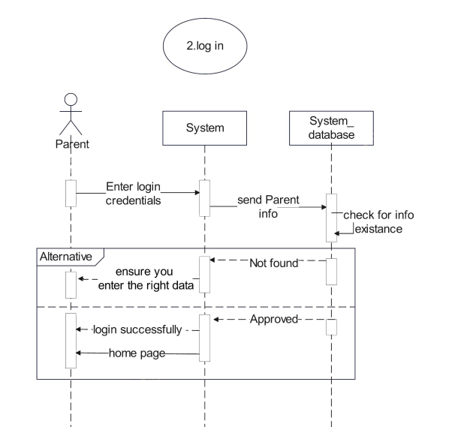
UML (Sequence Diagram)
update system info Sequence Diagram
doctor voice reports Sequence Diagram
Parent Log in Sequence Diagram

Slide 26
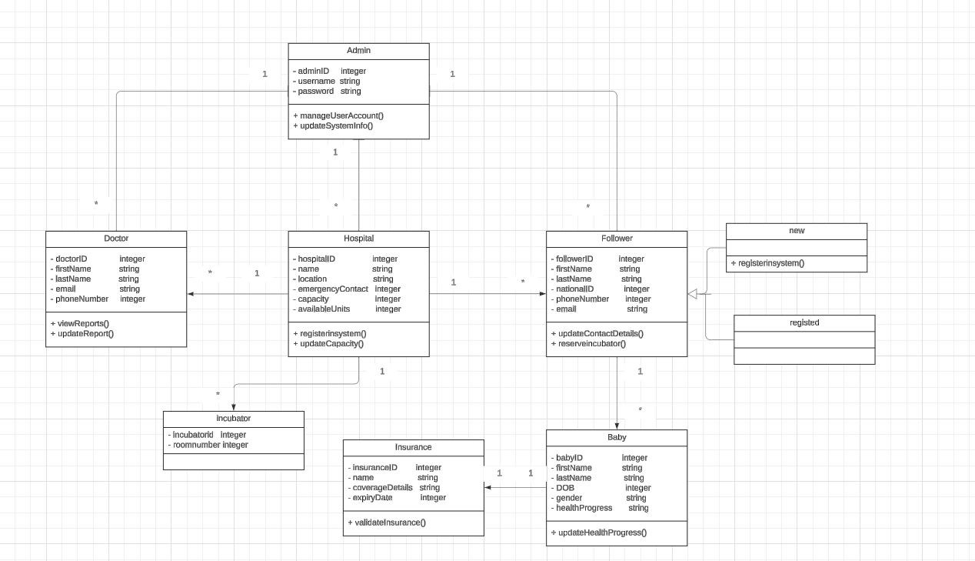
UML (Class Diagram)

Slide 27
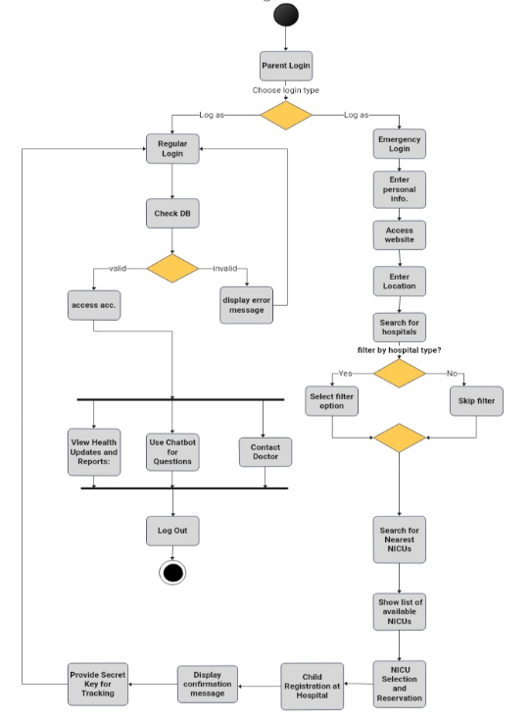
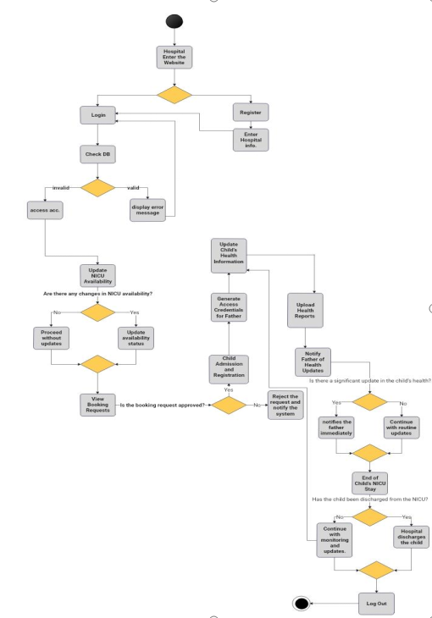
UML (Activity Diagram)

Slide 28
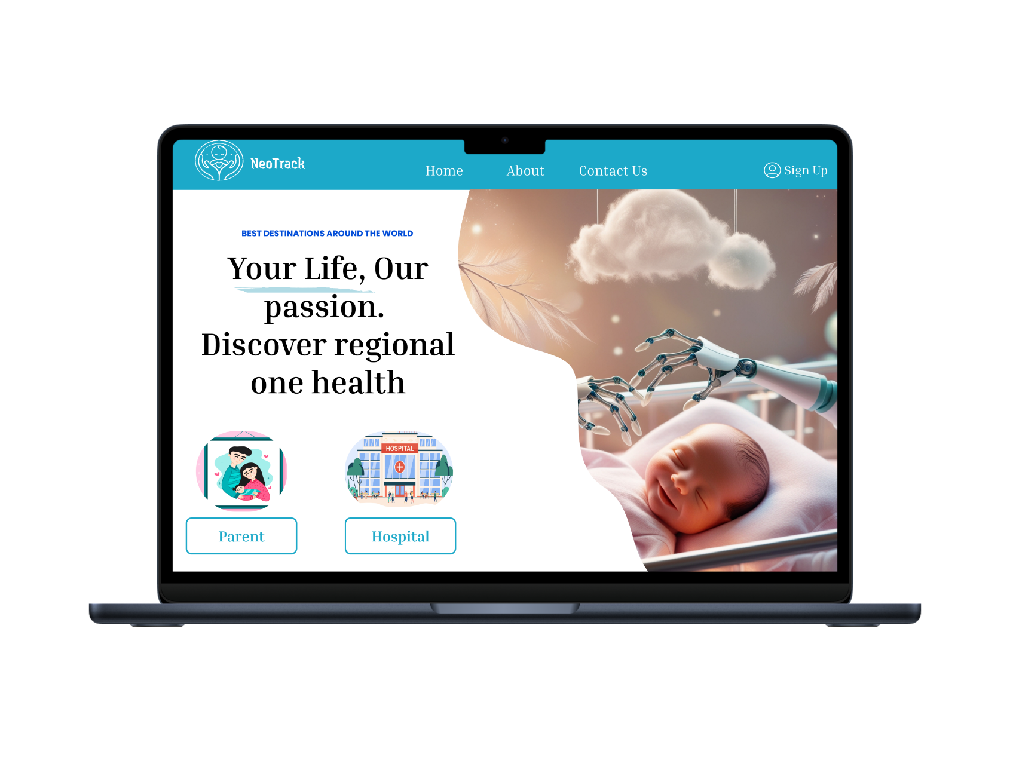
UI/UX Design
Our Home Page
The main entry point of the platform, offering a simple navigation choice for fathers and hospitals to access their respective functionalities

Slide 29
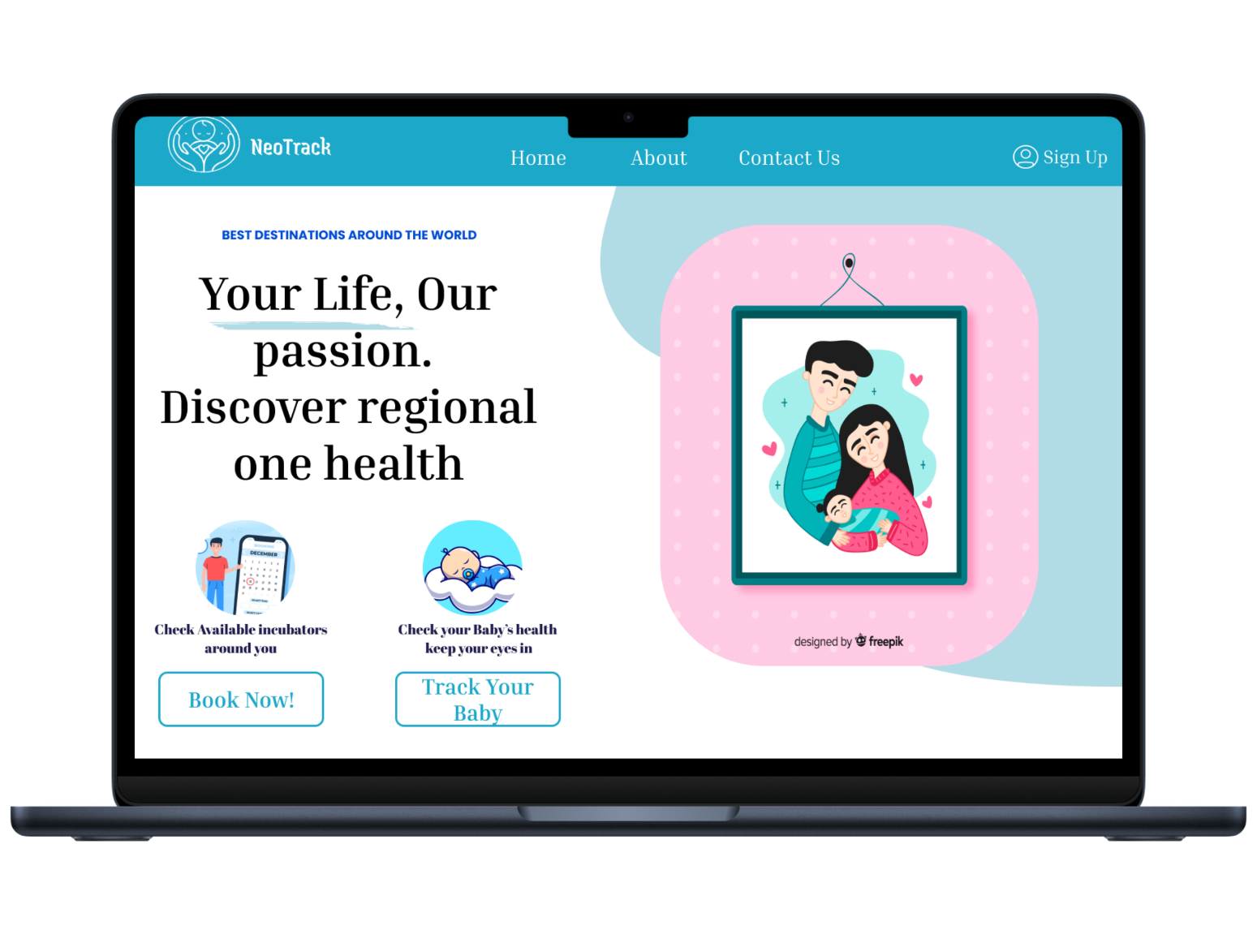
UI/UX Design
Parent Home Page
The primary interface for parents, providing seamless access to two essential features: booking a neonatal incubator and monitoring their baby's health and progress in real time.

Slide 30
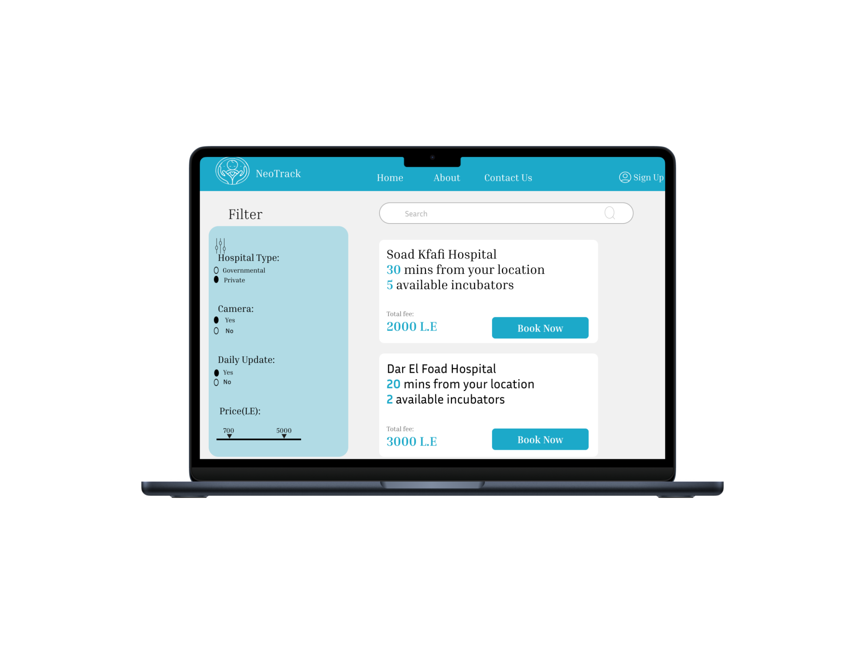
UI/UX Design
Booking Page
A booking interface for parents showing nearby incubators with filters for price, hospital type, camera availability, and daily availability updates

Slide 31
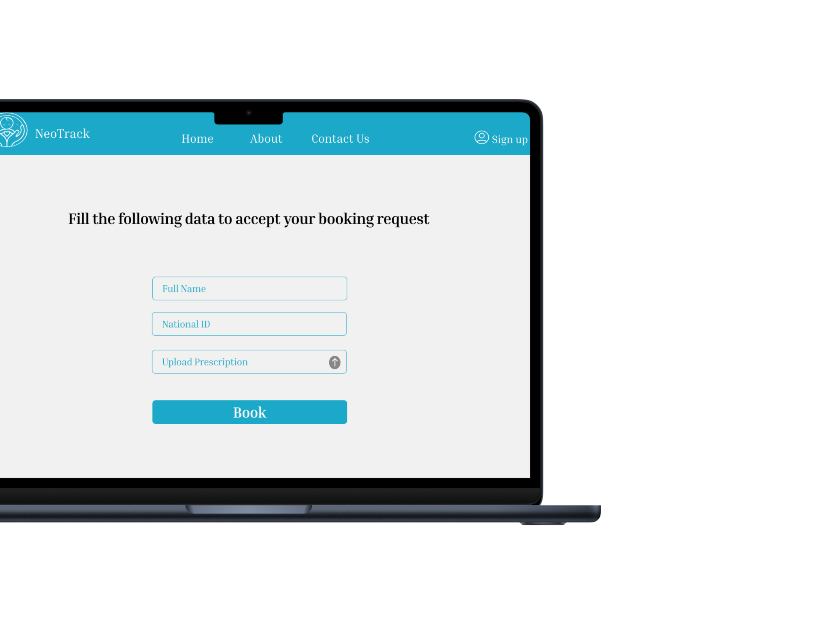
UI/UX Design
Booking form
A form where parents enter required details such as the prescription, name, and national ID number to complete the booking process

Slide 32
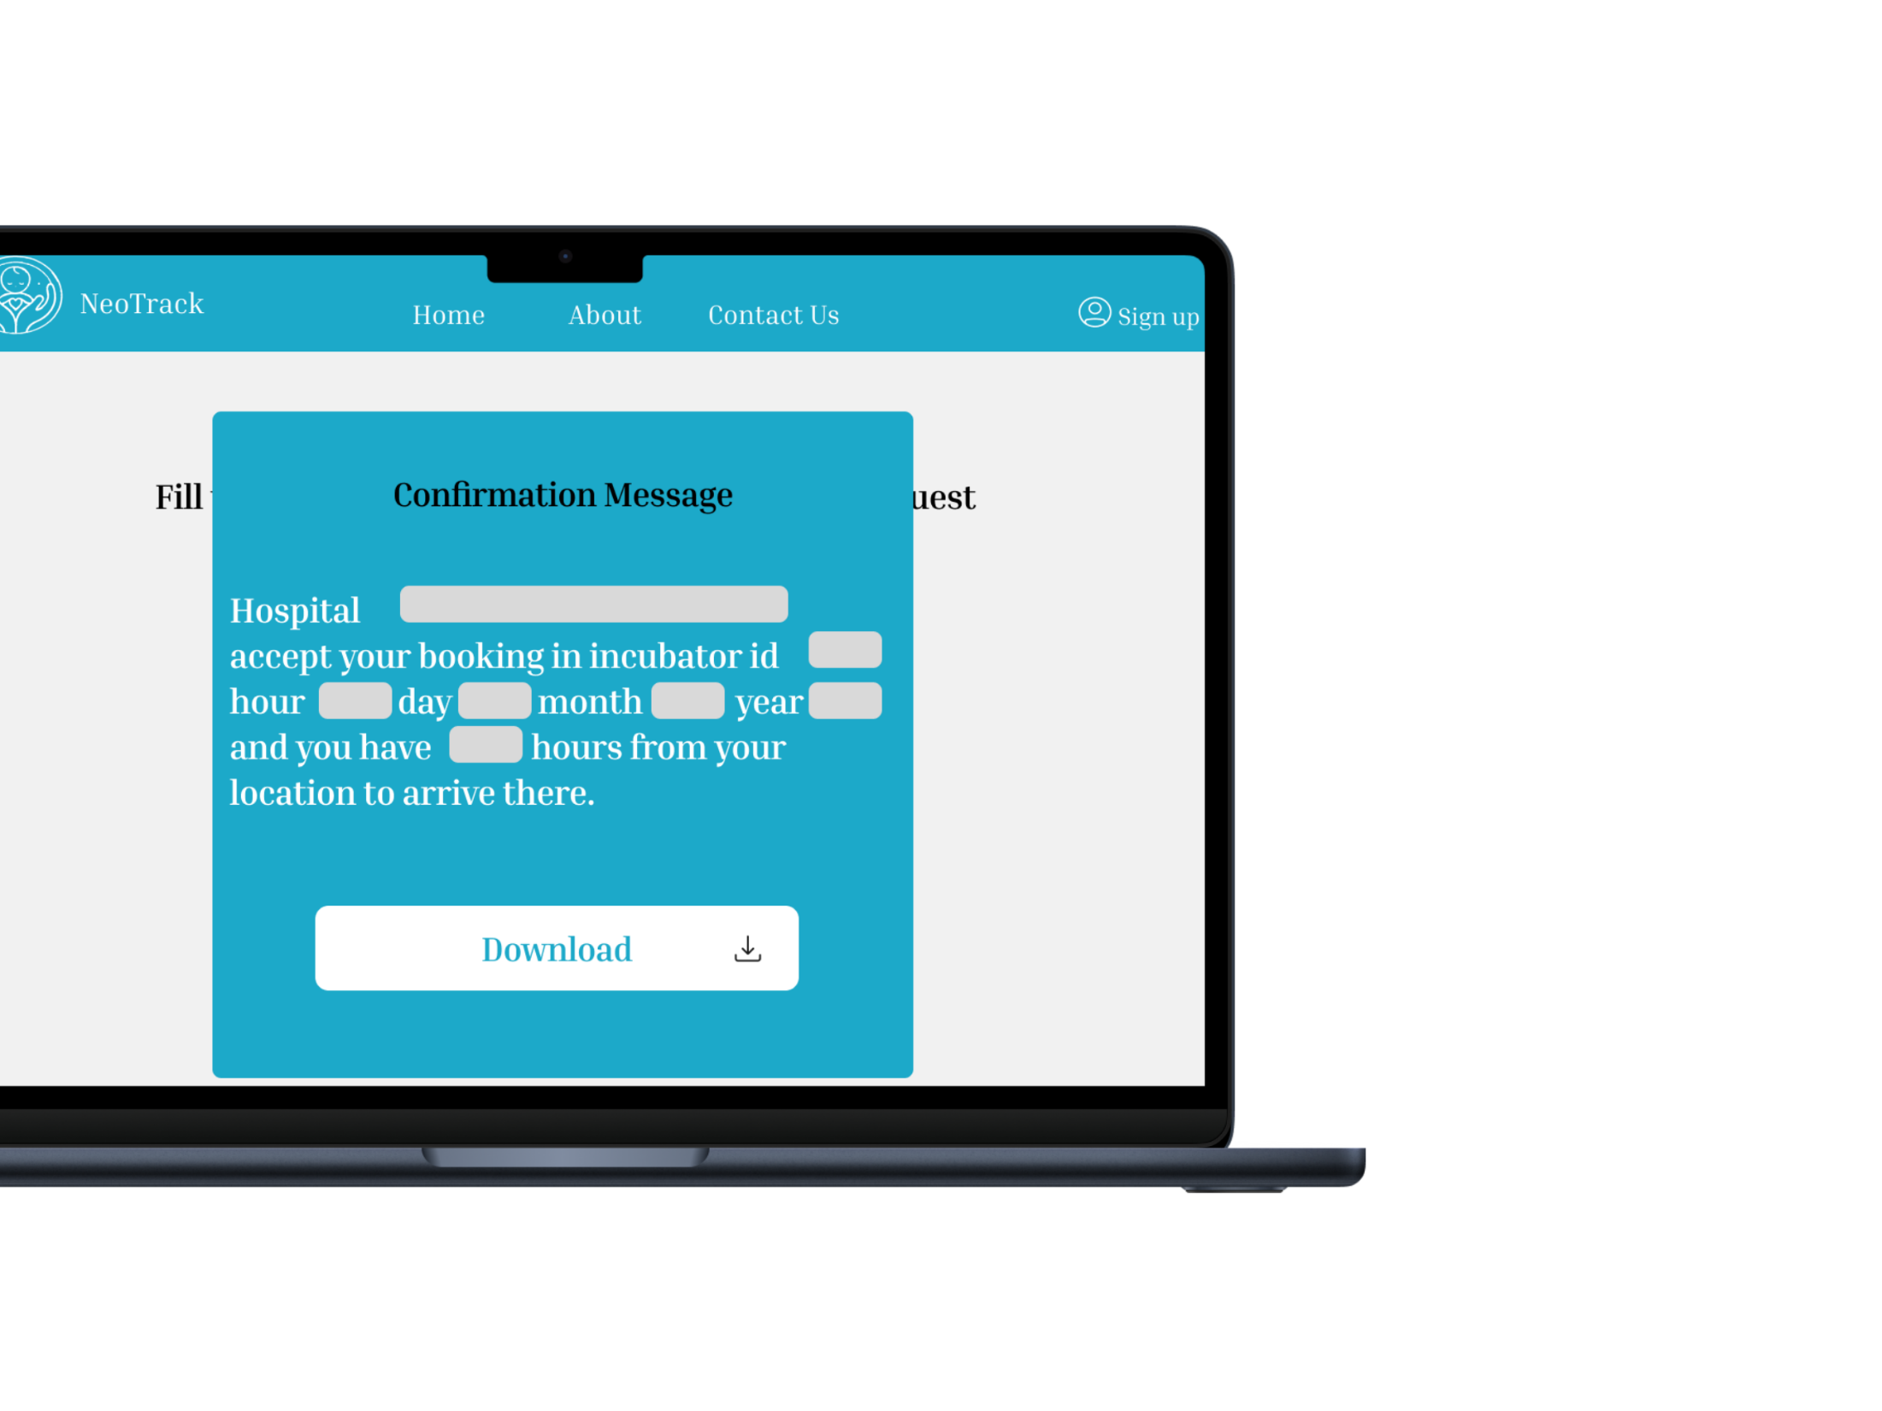
UI/UX Design
Booking confirmation message
A confirmation message displaying the booking details, including the estimated hours required to reach the selected incubator based on the parent's current location.

Slide 33
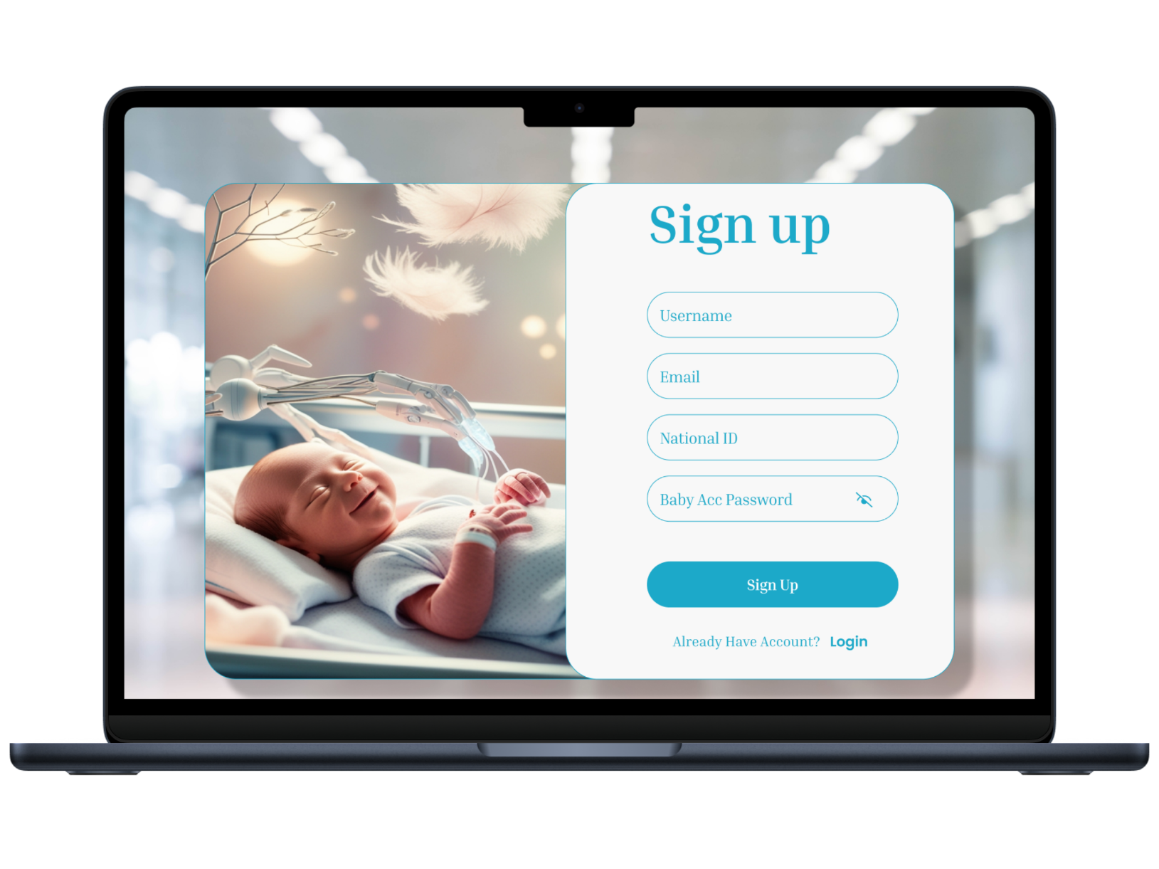
UI/UX Design
Parent Sign up Page
A registration page where parents provide their information, including name, contact details, and national ID, to create an account for tracking their baby's health and progress

Slide 34
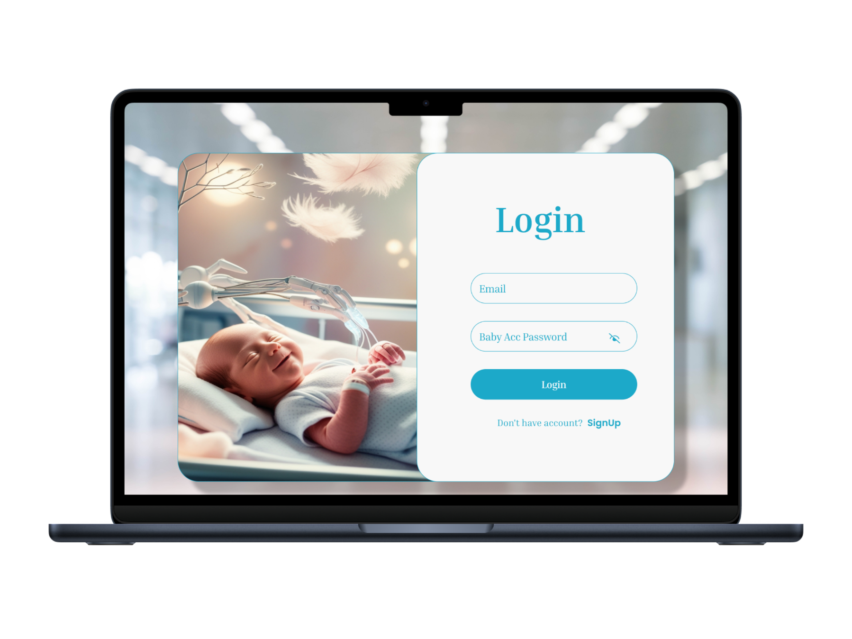
UI/UX Design
Parent Login Page
A login page where parents enter their credentials, such as national ID and password, to access their account and track their baby's health and incubator booking details.

Slide 35
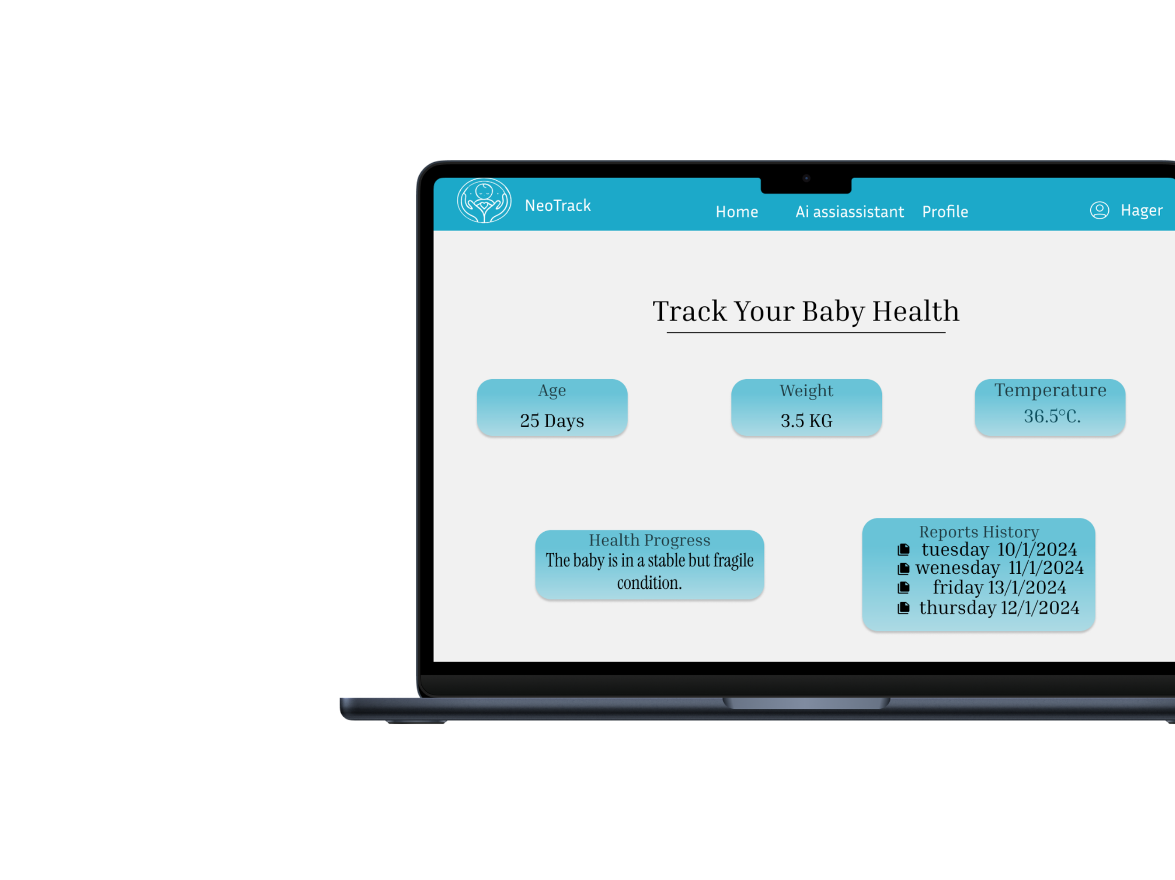
UI/UX Design
Baby Tracking Page
A dedicated tracking page displaying detailed information about the baby's health, progress, and incubator status, allowing parents to monitor their child's condition in real time

Slide 36
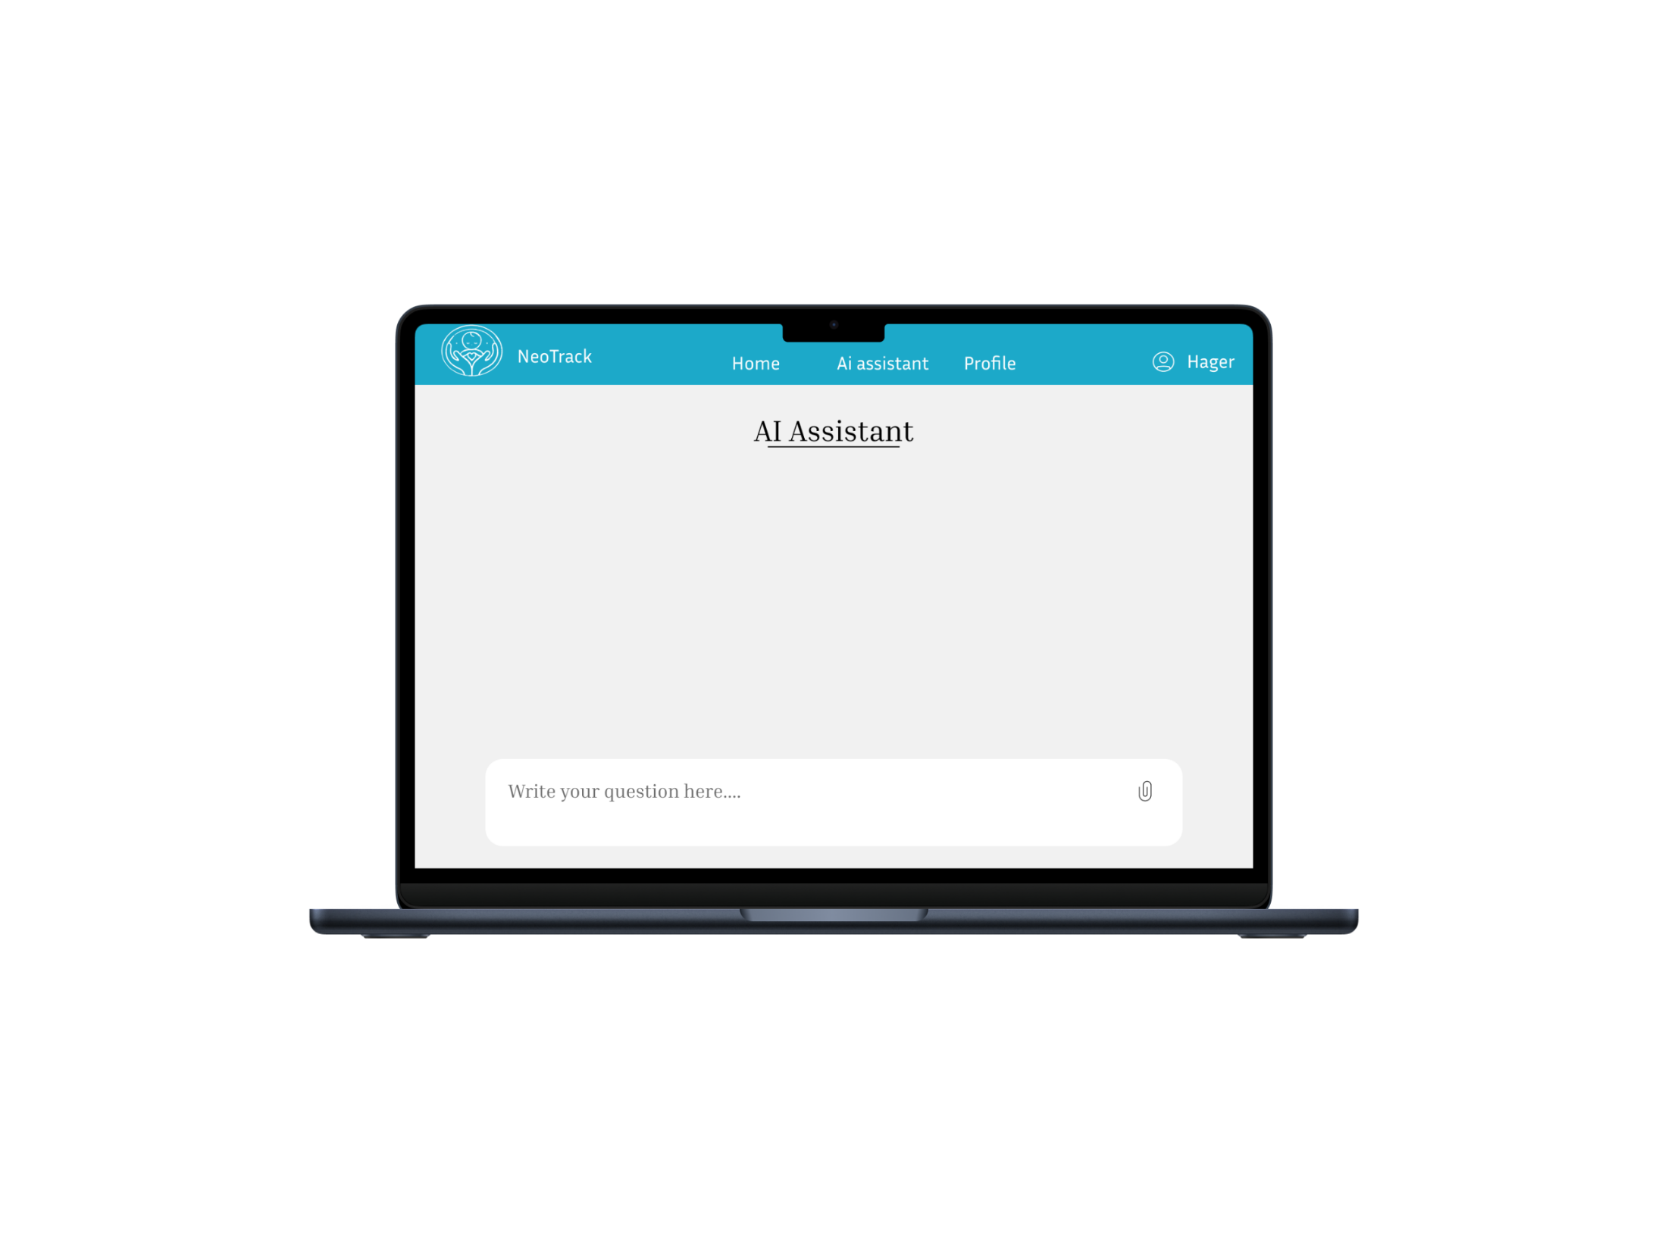
UI/UX Design
Health Assistant
A chatbot feature designed to assist parents with health-related questions, providing instant support and guidance regarding their baby's care and incubator status

Slide 37
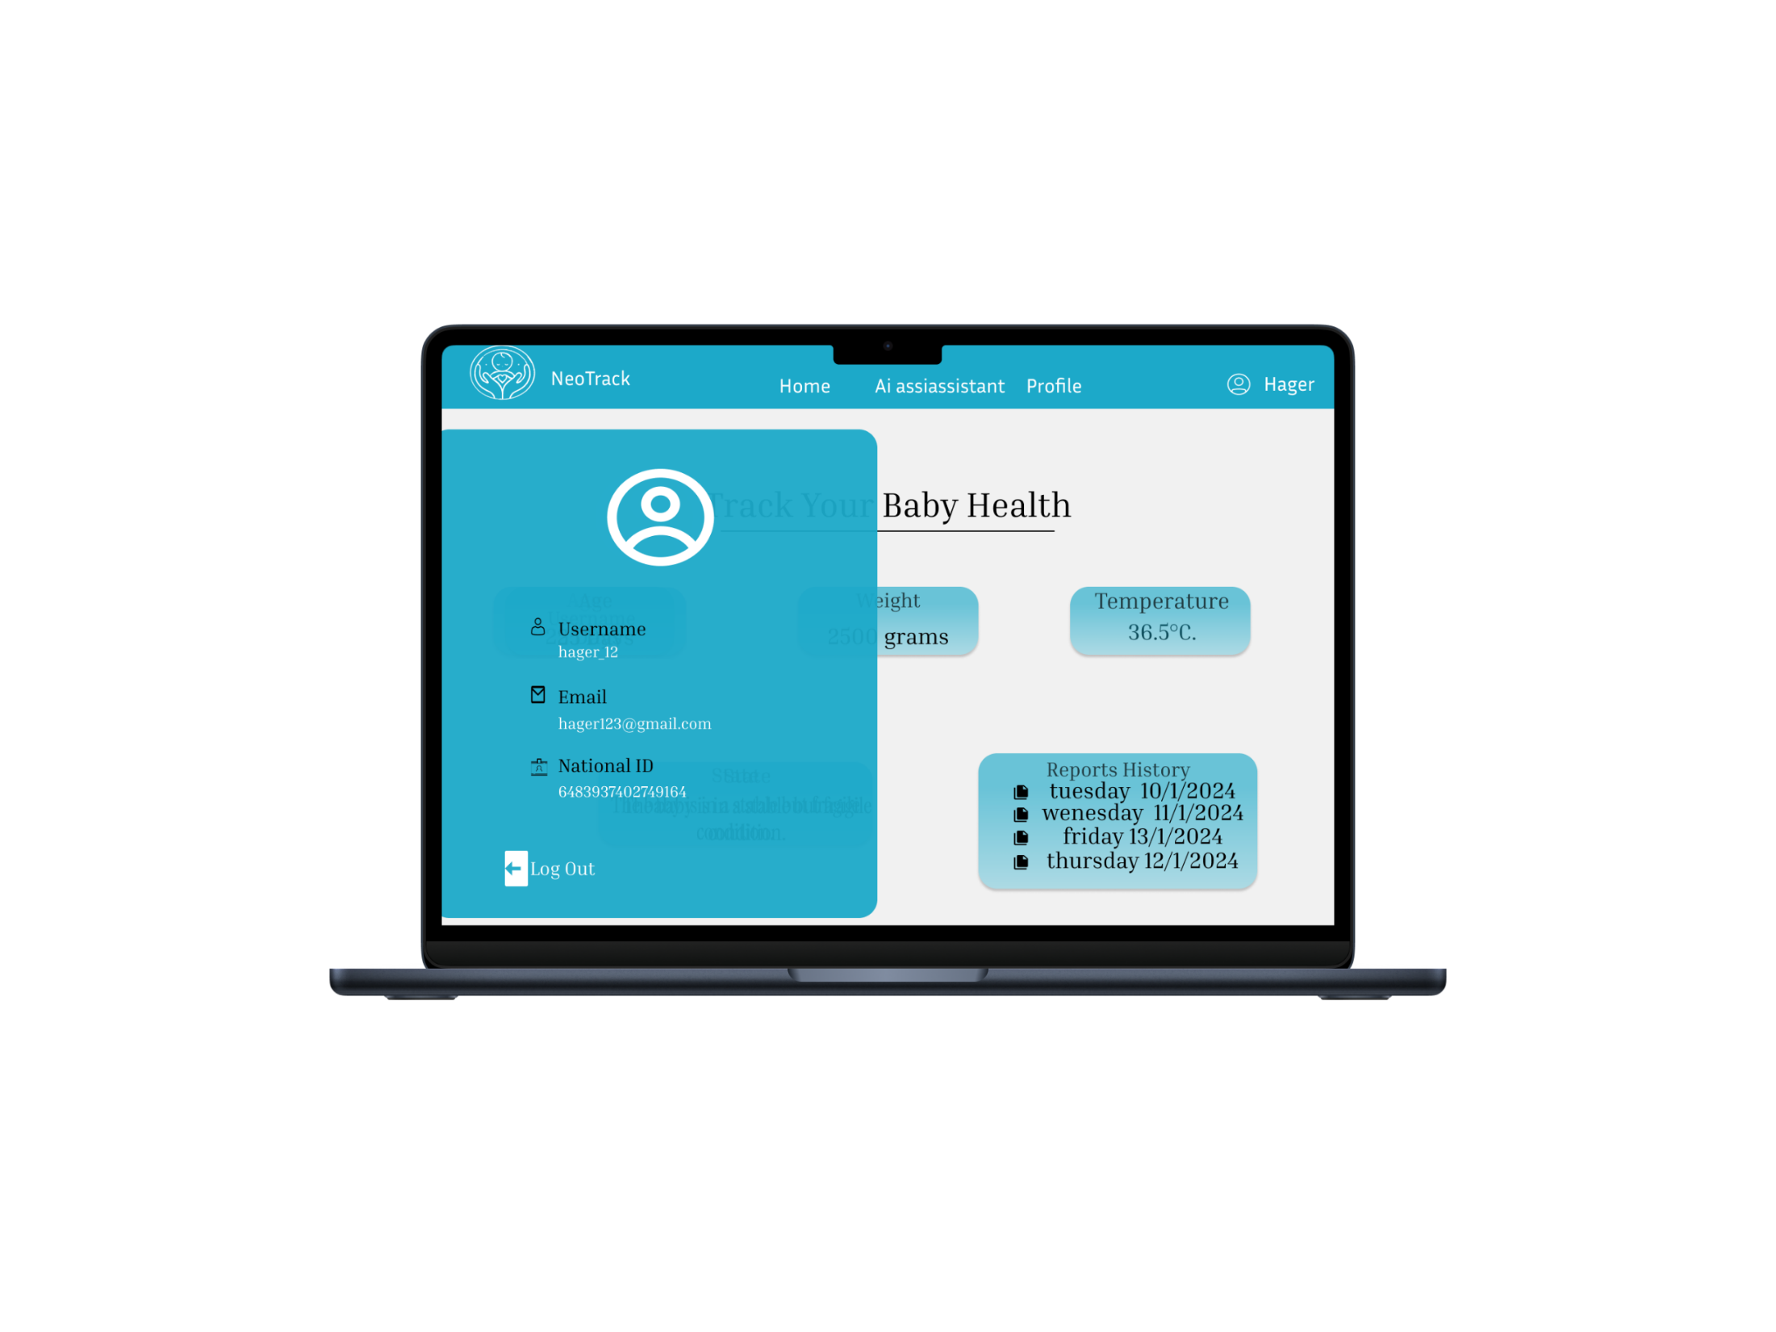
UI/UX Design
Parent Profile
A profile page displaying the parent's personal information, including name, contact details, and national ID.

Slide 38

UI/UX Design
Hospital Login Page
A login page for hospitals where authorized staff can enter their credentials to access the hospital’s dashboard, manage incubator bookings, and update availability

Slide 39
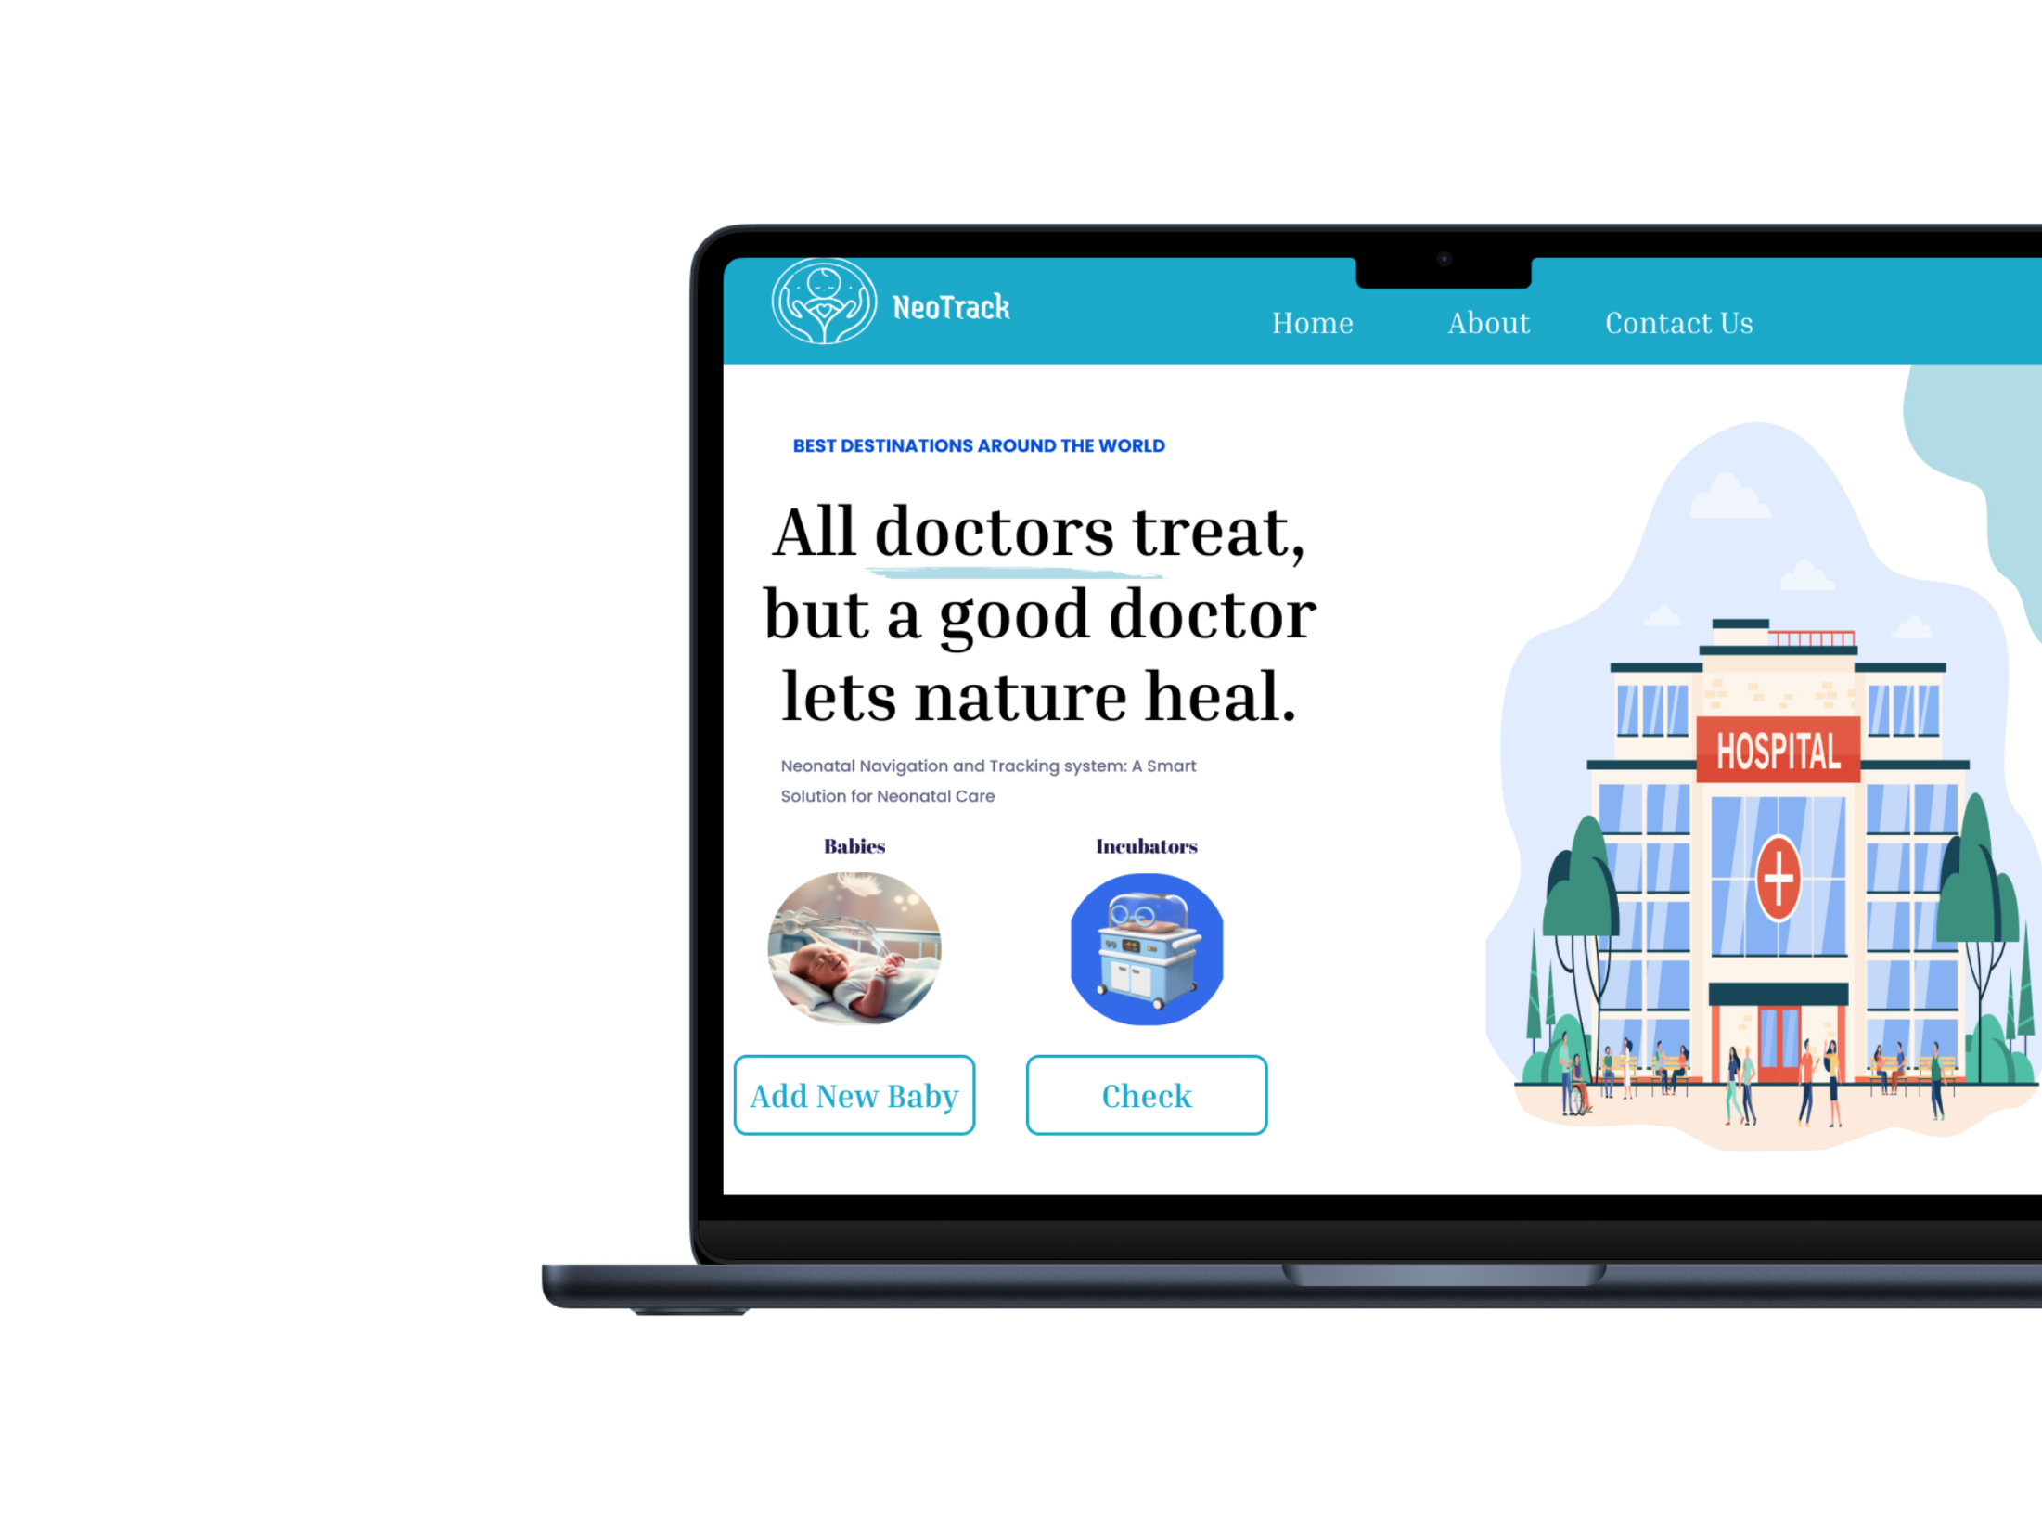
UI/UX Design
Hospital Home Page
The hospital's main dashboard, allowing staff to either check incubator availability or add a new baby to the system for tracking and management

Slide 40
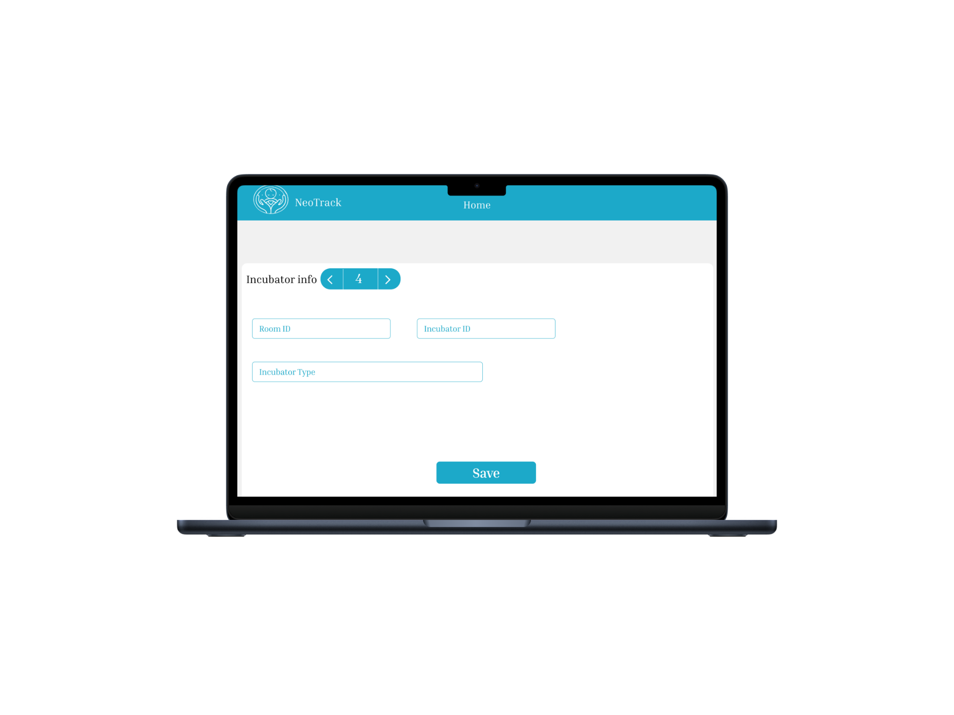
UI/UX Design
Add New Baby Page
A page where hospital staff can enter the baby’s details, such as name, birth date, and health information, to add the baby to the system

Slide 41
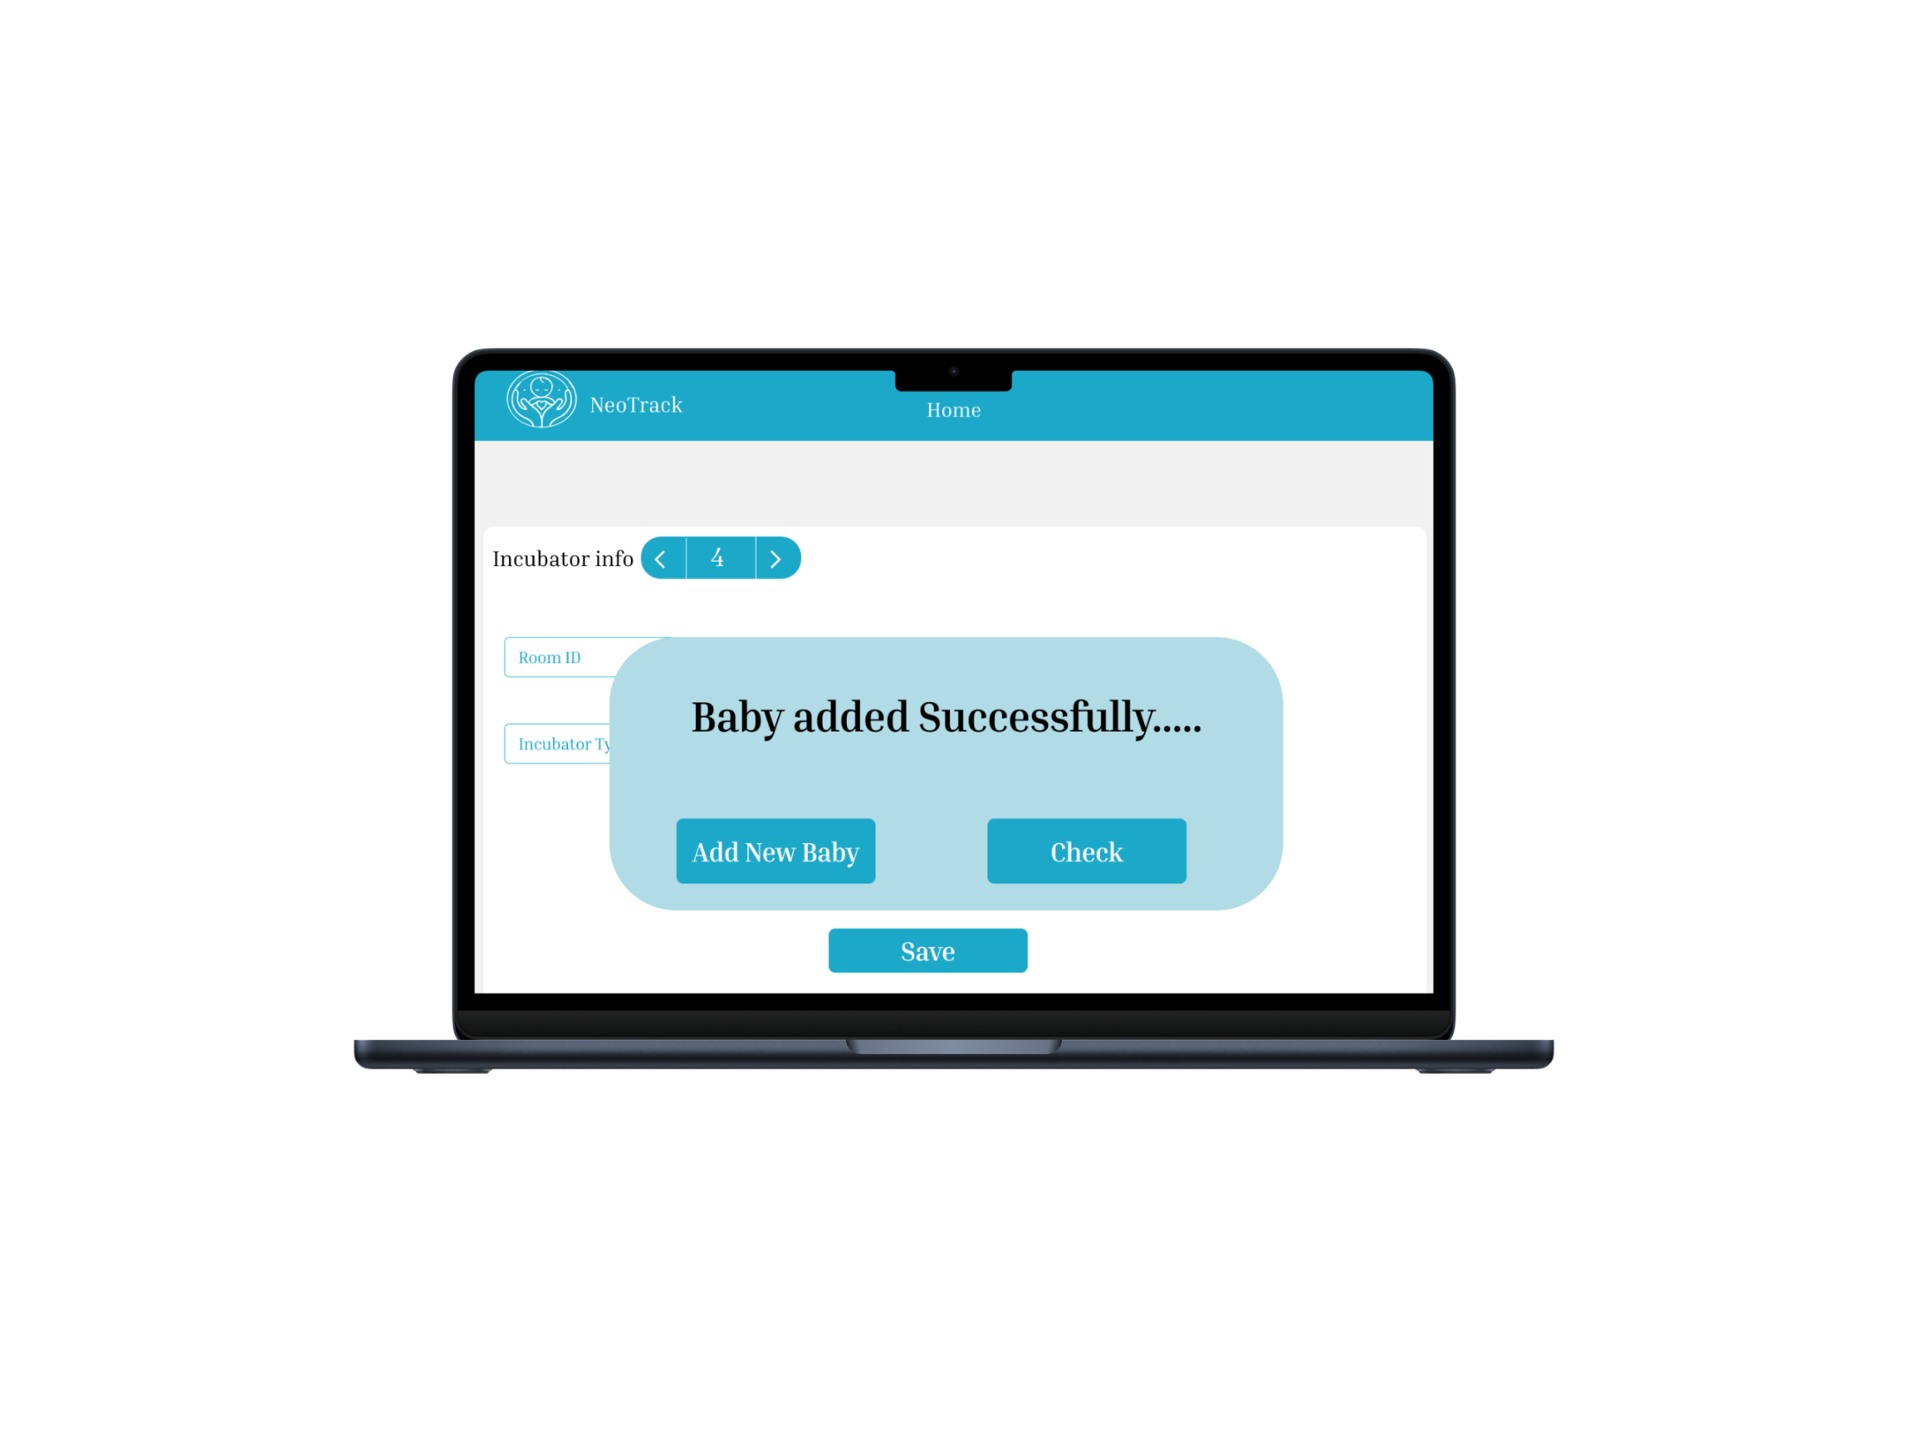
UI/UX Design
Message: Baby Added Successfully
A success message confirming the baby’s addition to the system, with options to either add another baby, check the newly added baby’s details, or review the availability of other incubators

Slide 42
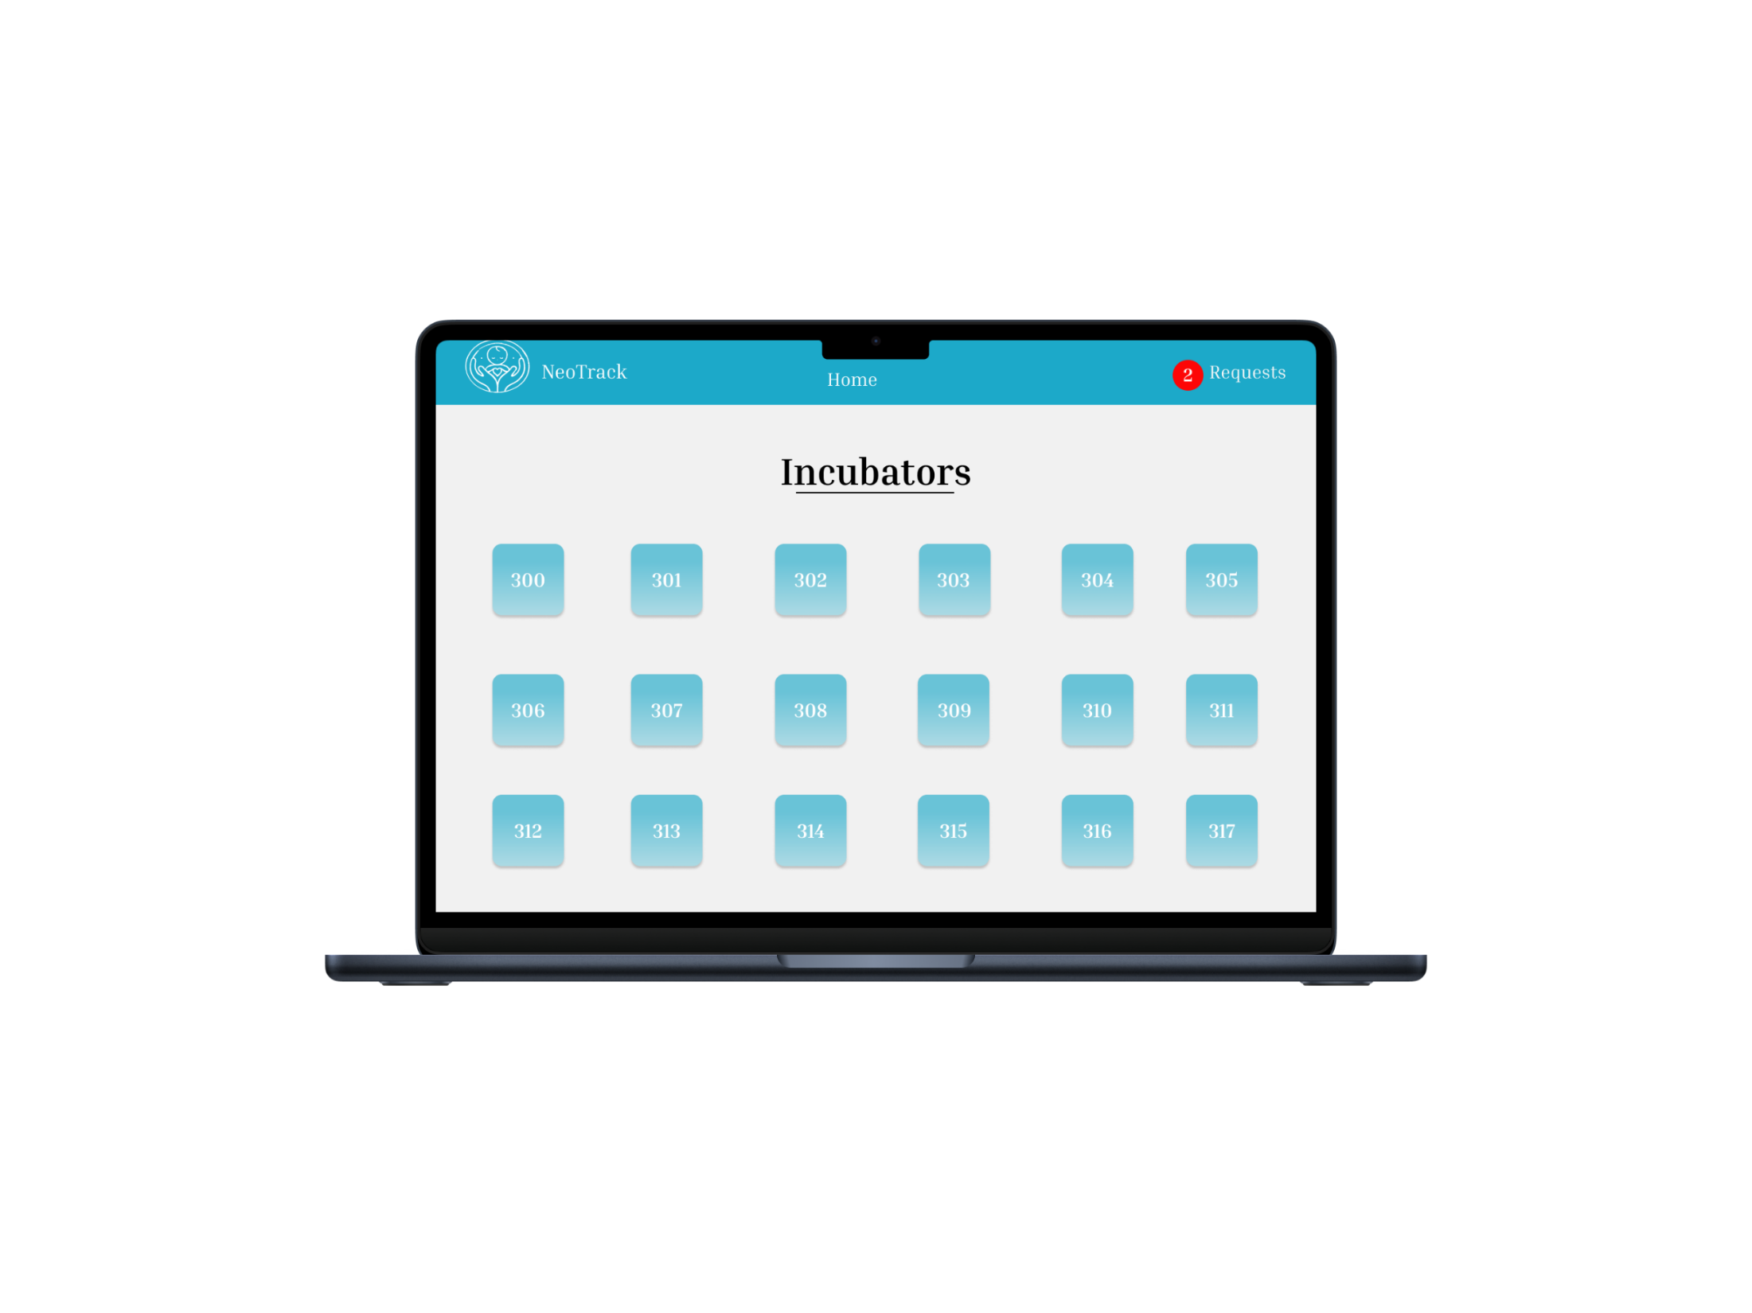
UI/UX Design
Incubators List
A page displaying a list of available neonatal incubators, showing their status, location, and relevant details for easy selection and management

Slide 43
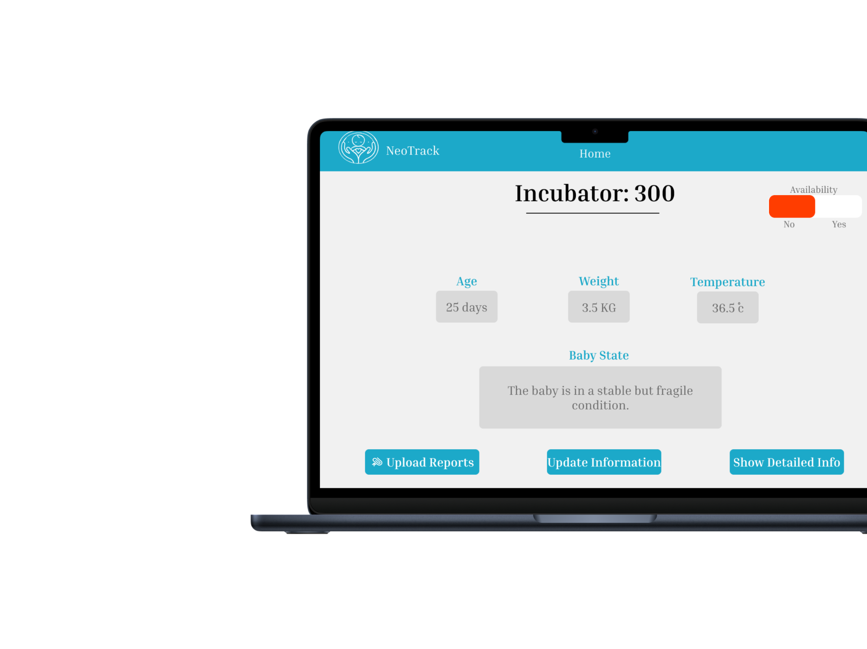
UI/UX Design
Add Health Update
A page where hospital staff can add updates on the baby's health status, including progress, treatment, and any necessary observations, which will be visible to the parent.

Slide 44
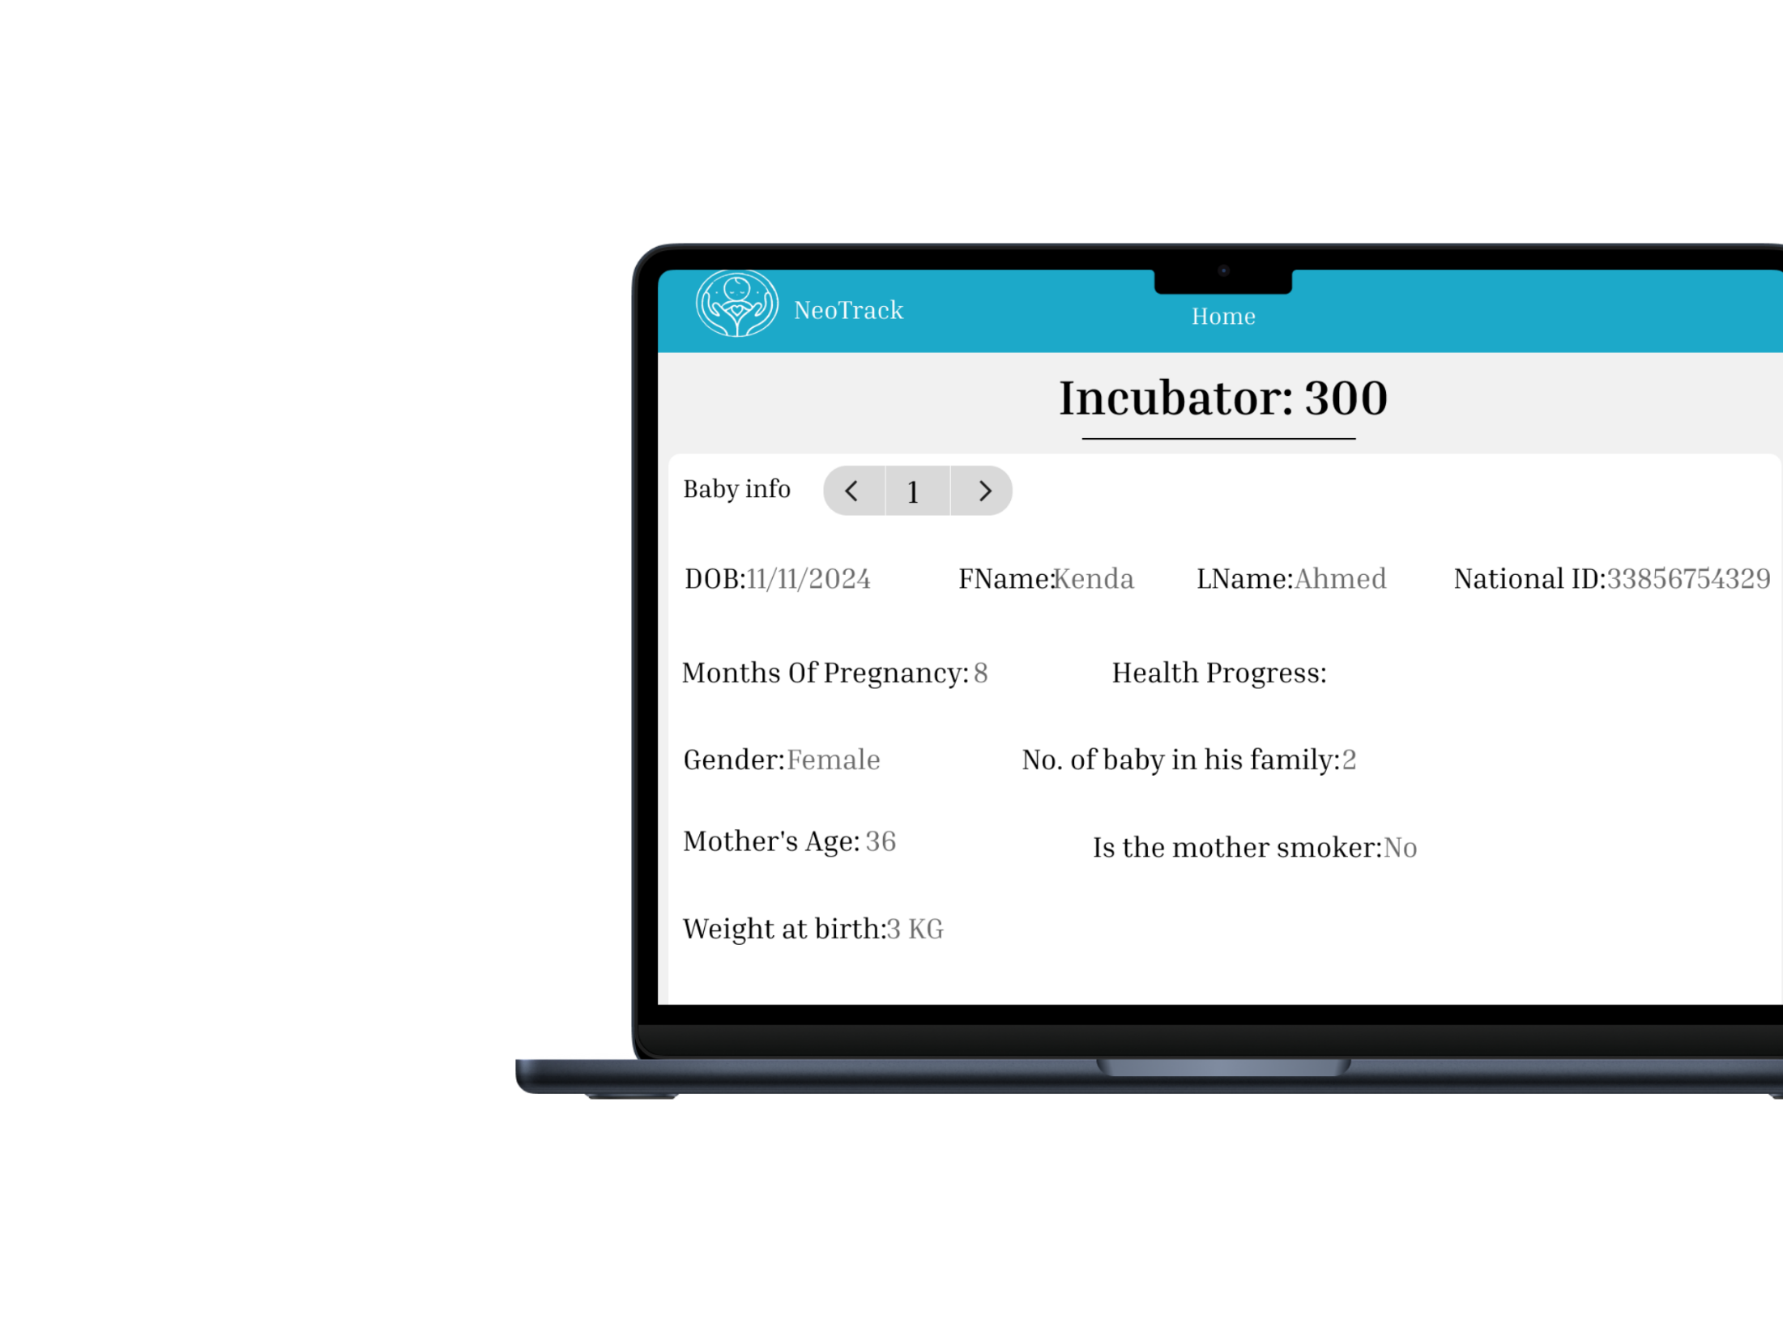
UI/UX Design
Show Detailed Info Page
A page where hospital staff can view and manage the health updates and information they’ve added about the baby, including treatment progress and any changes in condition

Slide 45
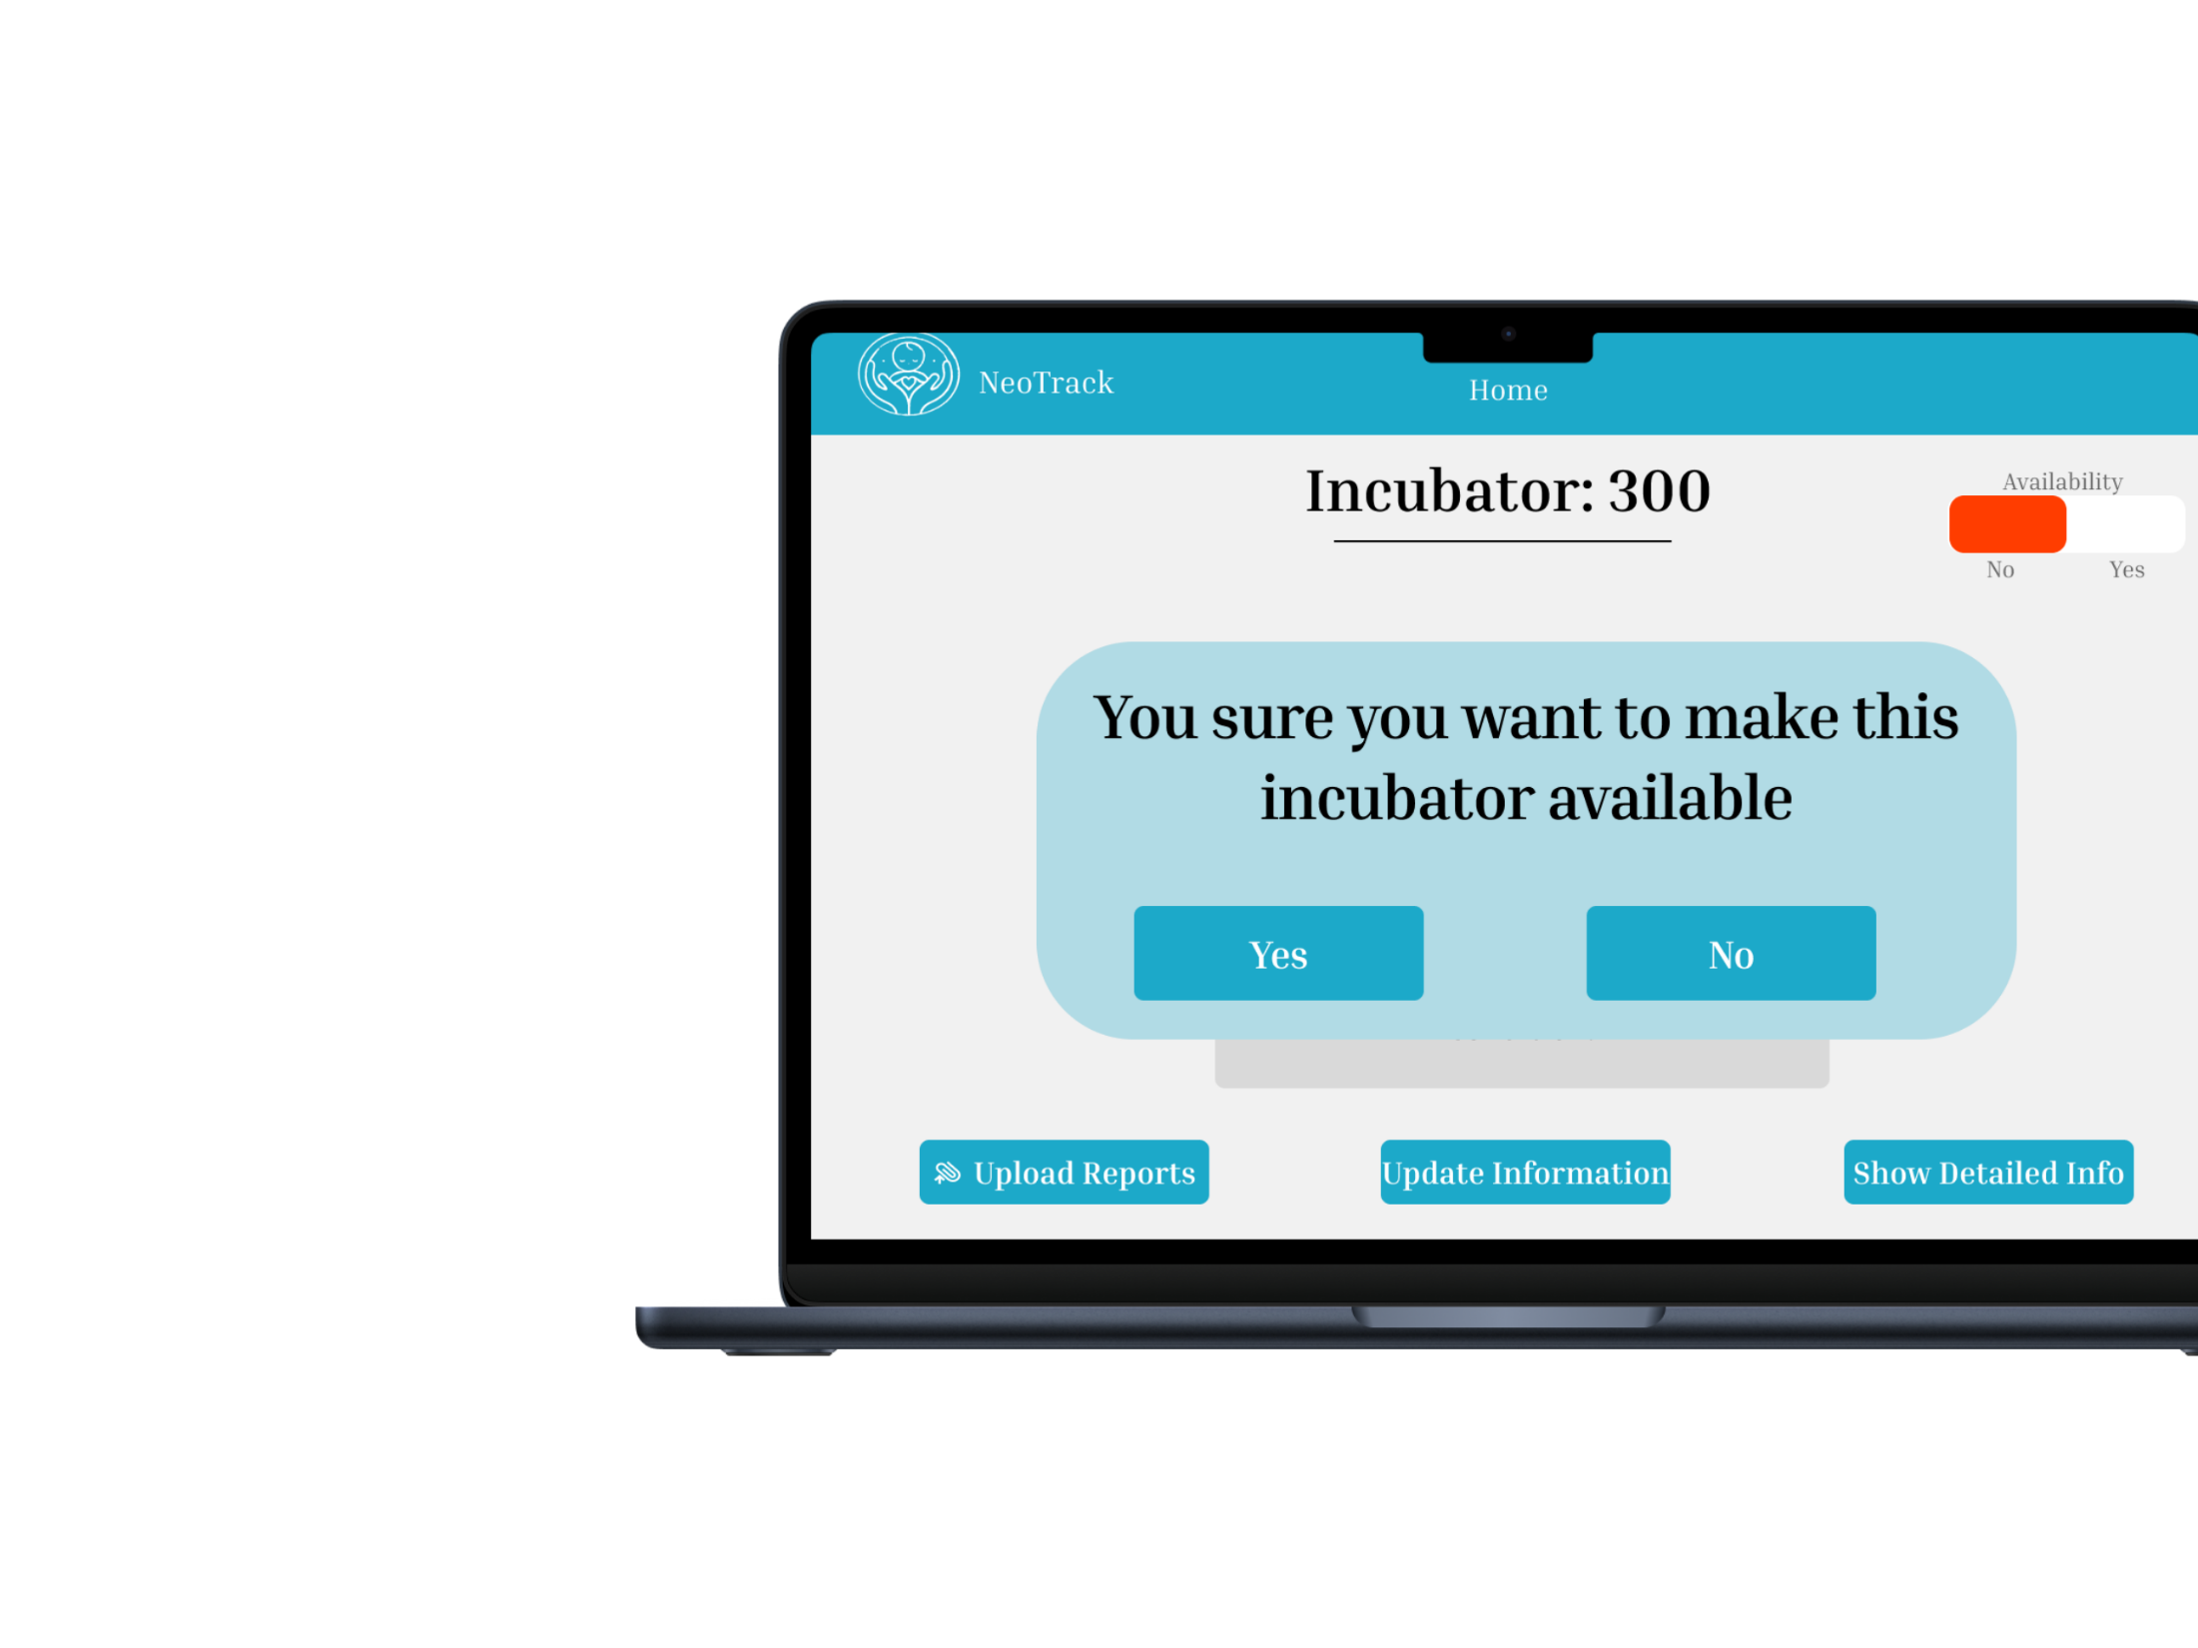
UI/UX Design
Free Up Incubator
A button that allows hospital staff to remove a baby from the incubator, marking it as available for new bookings

Slide 46
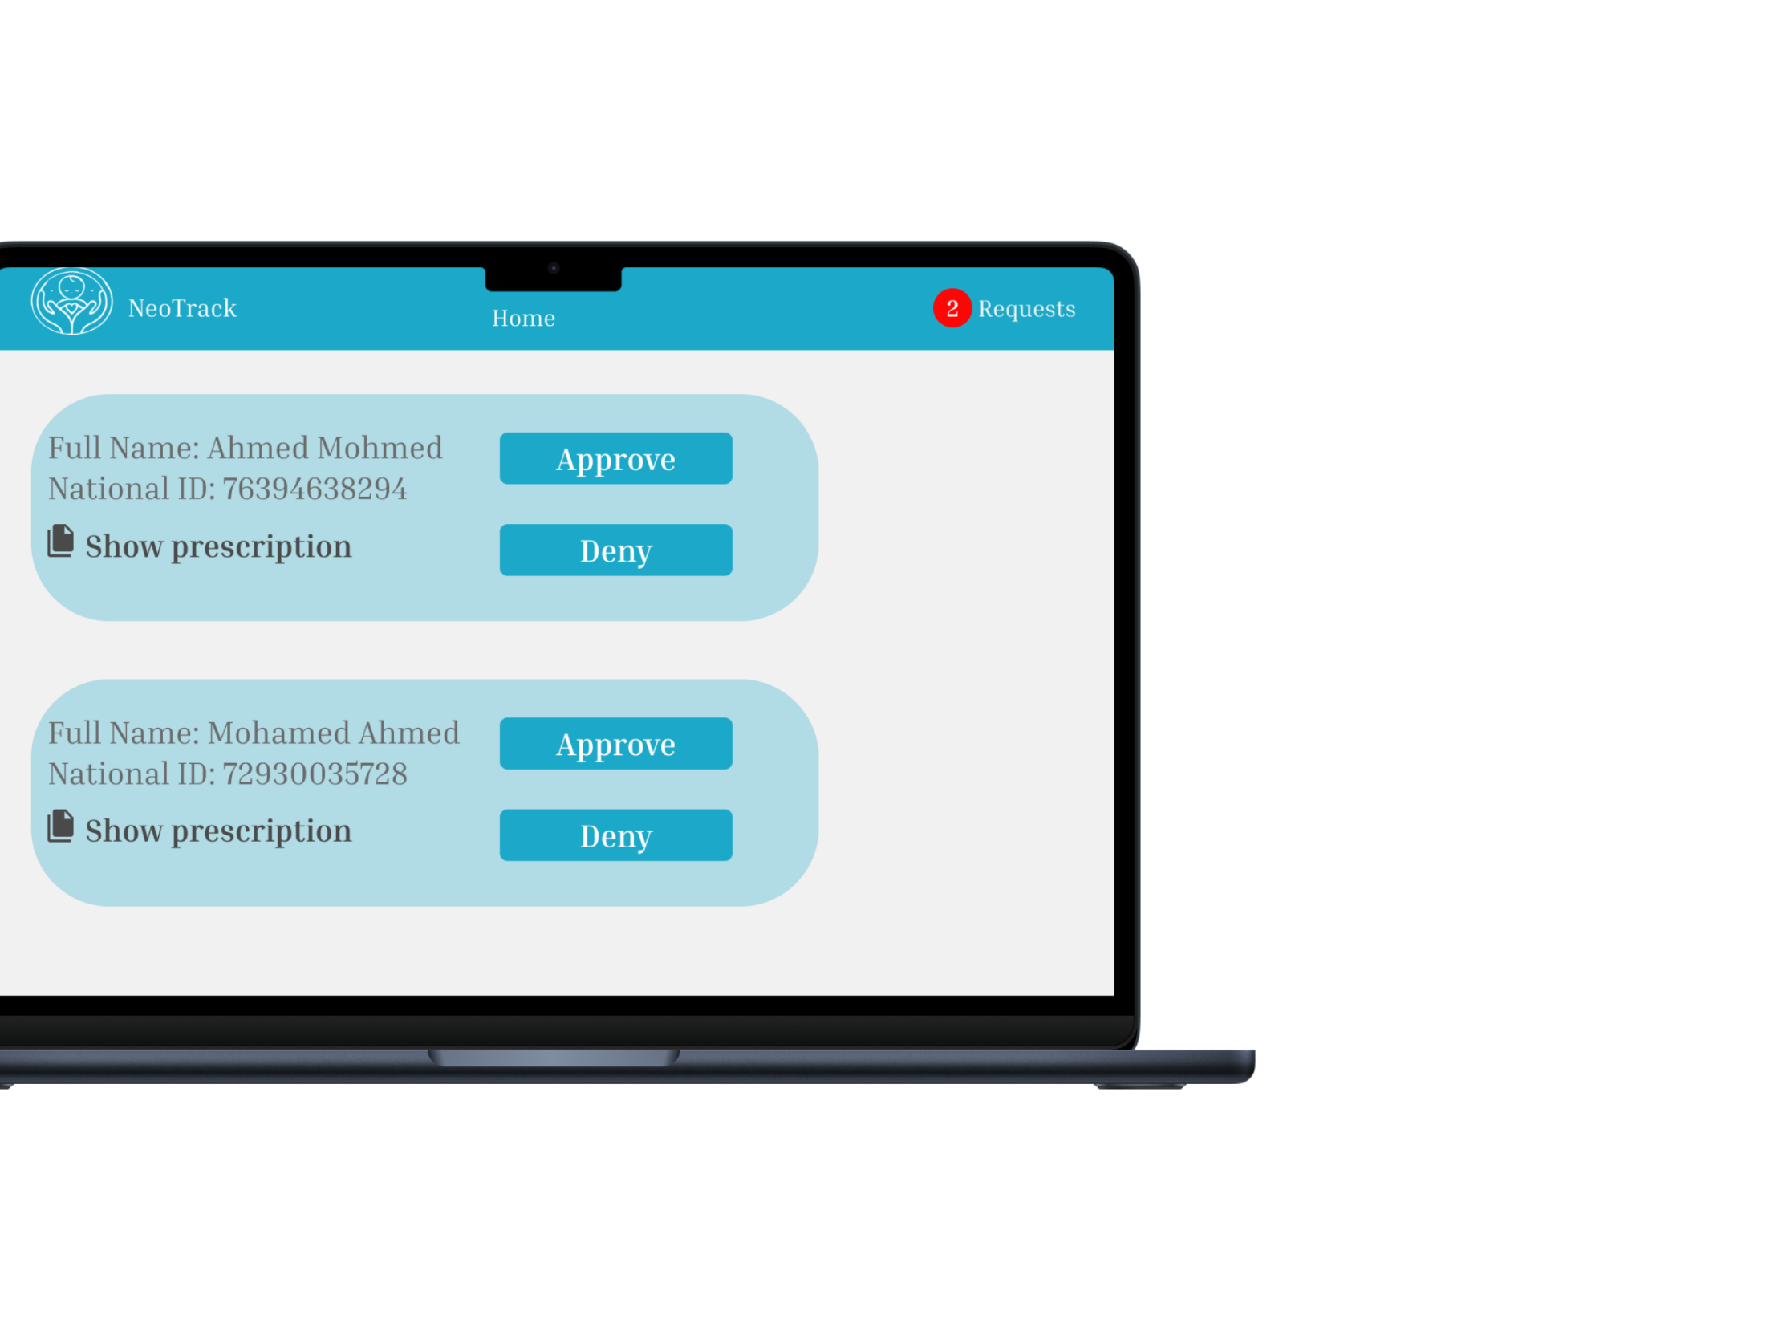
UI/UX Design
Manage Booking Requests
A page where hospital staff can view and manage booking requests from parents, with the ability to accept or reject requests based on the received data and incubator availability

Slide 47
Implementation Tools
Backend Development
Django:
Python-based web framework used for backend development.
Used to build the API and connect to the database.
Provides strong security features, authentication, and session management.
Ideal for web applications that require precise database control and scalability.
Frontend Development
HTML/CSS/JavaScript:
HTML: For building the structure of web pages.
CSS: For styling and ensuring a responsive design that adapts to various devices.
JavaScript: For adding interactivity to the web pages, including real-time updates like health status of the baby.
Database Management
MySQL:
An advanced relational database that supports efficient handling of complex and distributed data.
Used to store patient information, health records, and incubator reservation data.
UI/UX Design Tools
Figma:
A design tool for creating UI and prototypes.
Allows team collaboration and direct interaction with designs during the development phase.

Slide 48
Expected Outcome (Including SDGs)
The project also aligns strongly with global Sustainable Development Goals (SDGs), particularly:
SDG 3: Good Health and Well-being – By improving neonatal care access and outcomes, the project directly contributes to the reduction of preventable neonatal deaths.
SDG 10: Reduced Inequalities – Neonatal Nav bridges gaps in healthcare access, ensuring even underserved regions have access to critical resources.
SDG 11: Sustainable Cities and Communities – By fostering localized solutions, it supports community health infrastructure development.
SDG 17: Partnerships for the Goals – Through collaboration with hospitals, healthcare providers, and community organizations, the application promotes coordinated efforts to improve neonatal health.
At its heart, Neonatal Nav is driven by the desire to save lives and ease the burden on families during their most challenging moments. By combining the latest in web development, artificial intelligence, and healthcare innovation, this platform is not just a technological achievement—it is a step toward building a world where every newborn has an equal chance to thrive.

Slide 49
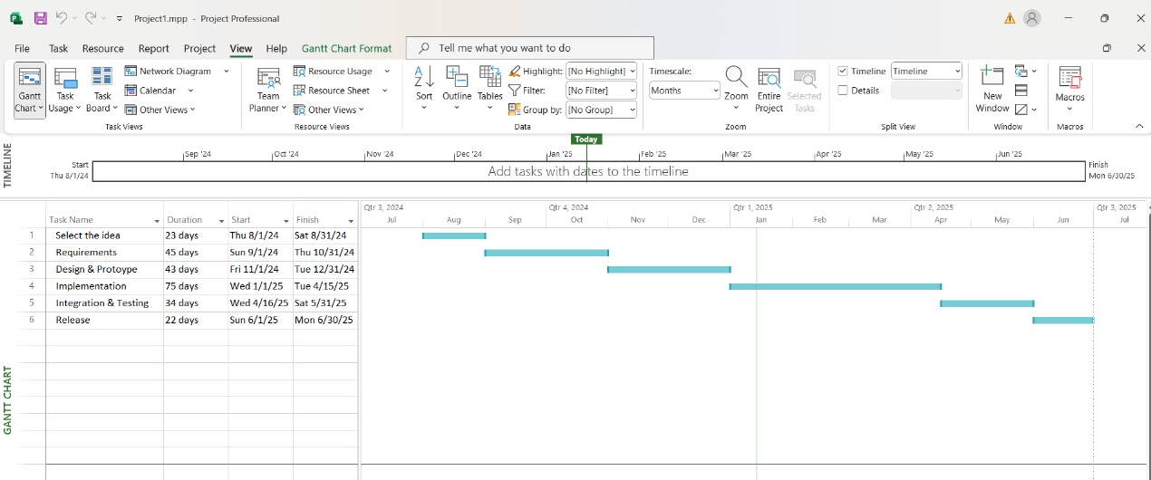
Project Plan (Gantt Chart)

Slide 50
Conclusion
In conclusion, addressing the challenges surrounding neonatal care requires a multifaceted approach that prioritizes accessibility, innovation, and empathy. This academic project proposes a comprehensive solution to bridge critical gaps in healthcare infrastructure, parental awareness, and communication.
By leveraging advanced technologies and user-centric design, the system aims to reduce neonatal mortality rates, streamline access to NICU facilities, and empower families with the tools and knowledge they need to care for their newborns.
This initiative not only underscores the potential of technology in transforming healthcare but also serves as a blueprint for creating equitable and sustainable neonatal care systems worldwide.

Slide 51
References (IEEE Format)
Books:
[1] Ian Sommerville, "Software Engineering" Pearson, 10th Edition, ISBN: 978-0133943030, 2015.
Journals or Periodicals:
[1]Ayman S. Abdelaziz, Hany Harb, Alaa Zaghloul and Ahmed Salem, “An Enhanced MCDM Model for Cloud Service Provider Selection,” International Journal of Advanced Computer Science and Applications(IJACSA), Vol.14, No.2, pp.70-77, 2023.
Articles from Conference Proceedings:
[2] D. B. Payne and J. R. Stern, “Wavelength-switched passively coupled single-mode optical network,” in Proc. IOOC-ECOC, 1985, pp. 585–590.
URL:
[1] "Cloud Harmony," [Online]. Available: https://cloudharmony.com/ [Accessed 01.01.2025]

Slide 52


